Slide 1
Class 12-14 Last Days
Keith A. Pray
socialimps.keithpray.net

Slide 2
Overview
Reminder: Course and Group Evaluations
Automation Paper Results
Points to date
Class 14:
Students Present
Students’ Choice

Slide 3
Notes:
Automation Paper results. This term’s additions in RED

Slide 4
Papers
Great improvement!
Many students highest grade yet!
Much better backing data!
Notes:
Save for next time:
More Clear Conclusions
Significant Counter Points
Clearly state conclusion
First statement preferred
Absolute statements are difficult to prove
Avoid: all, always, any, every, everyone, never, none… unless you can show it
Be sure to put quotes around entire quote
Hyperbole is the best thing ever!
but not in these papers
Print 2 sided and save a tree
Use template, saves time (and -1 point)
Include Counter Point and Response
Include Author, Title, Publish Date, Publisher for references
Read paper aloud to proof

Slide 5
Grades To Date
56 Max Possible
- Discussion 1-12 - Papers 1-4
Does not include points:
- 4 Discussion - 10 Individual Presentation - 35 Group Project - Extra Credit

Slide 6
DRM Vs The Consumer: How Far is Too Far?
Shawn Greenwood

Slide 7
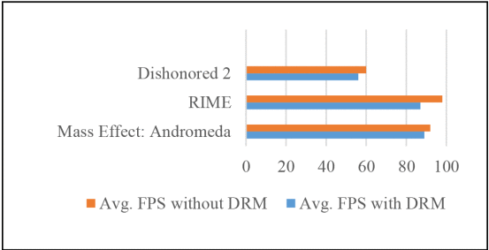
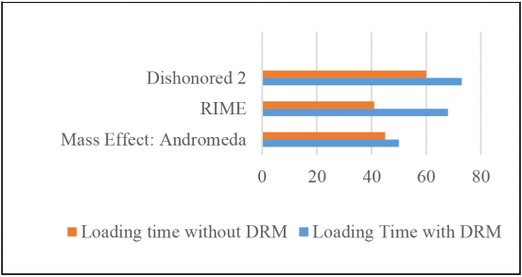
Invasive DRM causes more harm than good
Shawn Greenwood
Games with DRM run 8% slower and load 32% slower[2]
Invasive DRM can cause accessibility tools to malfunction[3]
Poorly written DRM can even cause system crashes[2]
Notes:
Here we have an example of drm impacting video game performance. These figures were taken on mid-range pc specs with and without denuvo drm. We can see that the games run 8% slower, which is the around the difference between 50-60fps, and load 32% slower, which is similar to the difference between 10-15 seconds. Both of these would negatively impact someone’s gaming experience, and leave them dissatisfied as customers. Another thing invasive DRM does is break accessibility tools. In 2007, there was a study that found that many PDF and EPUB drms were breaking screen readers, leaving the books unusable for the blind. There are also examples of DRM preventing closed captions for the deaf or breaking accessibility tools for video games. Poorly written DRM can also cause software or even system crashes, like denuvo has and like securom and starforce have in the past.

Slide 8

Why do people pirate in the first place?
Shawn Greenwood
Piracy is a low-risk, high-reward crime[4][5]
Influence by friends and family[4]
Lack of availability[4][6]
Rare cases where people Pirate to avoid DRM
Notes:
To understand how to solve the problem of bad drm usage, we have to understand why people pirate in the first place. Piracy is, by nature, a low risk high reward crime. It is rarely persecuted, and provides free music, movies, software, games, etc. to people who commit it. This makes it easier to justify doing. Another reason people pirate is through influence of others. If a friend tells you to watch a show, and you respond by saying you don’t have the streaming service its on, and your friend sends you a link to the show on a pirate site, you are more likely to click that link and watch that show. Another reason for piracy is the lack of availability of legal purchasing means. If there is no way to legally obtain a desired video game or movie, it is more likely to be pirated. Lastly, I know some people personally who pirate out of spite when they see invasive drm on a product. It’s also littered around comment sections of news articles about the DRM, so it’s prevalent, but the actual numbers are unknown.

Slide 9
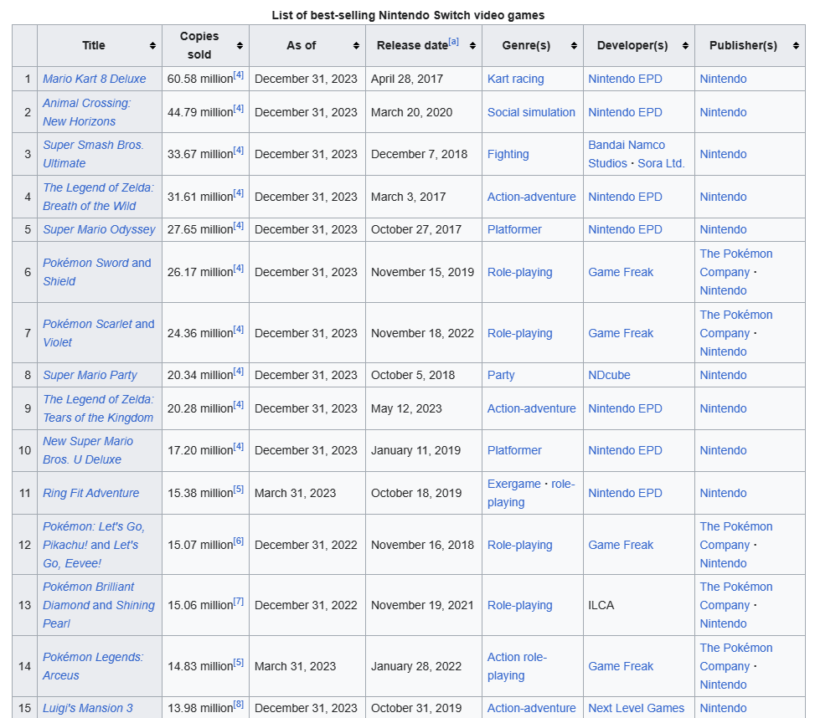
Less restrictions Benefit Everyone
Shawn Greenwood
Ensuring software availability can increase profits[image]
Customers will choose the more convenient option[4]
Customers get the media they want, corporations get profits
Notes:
The easiest way to combat piracy would be to loosen up on the restrictions and make things available and convenient for customers. 4 of the 15 best selling Nintendo switch games are remakes, remaster, or ports, which suggests that the demand for older games exists, and this premise can be extended to other mediums as well. Those remakes sold over 100 million copies, generated hundreds of millions of dollars in revenue for Nintendo and satisfying their customers along the way. Nintendo in particular has a large backlog of games that could be ported forward for even more profits.

Slide 10
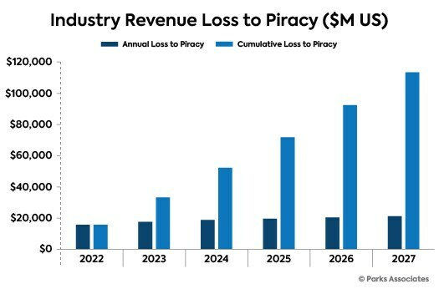
DRM is a necessary evil
Shawn Greenwood
Lost revenue statistic is misleading, worst-case scenario
Piracy does actually lead to lost sales[1]
DRM’s influence on products should be minimized
Notes:
At this point, it may seem like I’m arguing for drm to disappear entirely, but that isn’t the case. While the statistics around piracy revenue losses are shaky at best, since they often pretend that individual downloads of pirated media equate to lost sales, the truth is that some revenue is lost to piracy each year, and that revenue loss does have real life consequences like layoffs and even bankruptcy. The point I’m trying to make is that the restrictions imposed by DRM should be unintrusive and should be minimized whenever possible to offer maximum convenience to the consumer. This is the only way corporations can genuinely compete with pirates

Slide 11
References
Shawn Greenwood
[1]Associates, P. (n.d.). Parks Associates Forecasts Cumulative Revenue Loss to Piracy from Streaming Services to Surpass $113 Billion by 2027 in US Market. Retrieved May 1, 2024, from https://www.prnewswire.com/news-releases/parks-associates-forecasts-cumulative-revenue-loss-to-piracy-from-streaming-services-to-surpass-113-billion-by-2027-in-us-market-301799825.html
[2]Karthik, J., Amritha, P. P., & Sethumadhavan, M. (2020). Video Game DRM: Analysis and Paradigm Solution. 2020 11th International Conference on Computing, Communication and Networking Technologies (ICCCNT), 1–4. https://doi.org/10.1109/ICCCNT49239.2020.9225560
[3]Kramer, E. F. (2007). Digital Rights Management: Pitfalls and Possibilities for People with Disabilities. Journal of Electronic Publishing, 10(1). https://doi.org/10.3998/3336451.0010.106
[4]Limayem, M., Khalifa, M., & Chin, W. W. (2004). Factors motivating software piracy: A longitudinal study. IEEE Transactions on Engineering Management, 51(4), 414–425. https://doi.org/10.1109/TEM.2004.835087
[5]Mishra, A., Akman, I., & Yazici, A. (2006). Software piracy among IT professionals in organizations. International Journal of Information Management, 26(5), 401–413. https://doi.org/10.1016/j.ijinfomgt.2006.01.004
[6]Yue, Y. (2020). The effects of movie piracy on box-office revenue: An empirical analysis of the Chinese movie market. Journal of Applied Economics, 23(1), 618–655. https://doi.org/10.1080/15140326.2020.1812477

Slide 12
Your content is being served
Lana Cagle

Slide 13
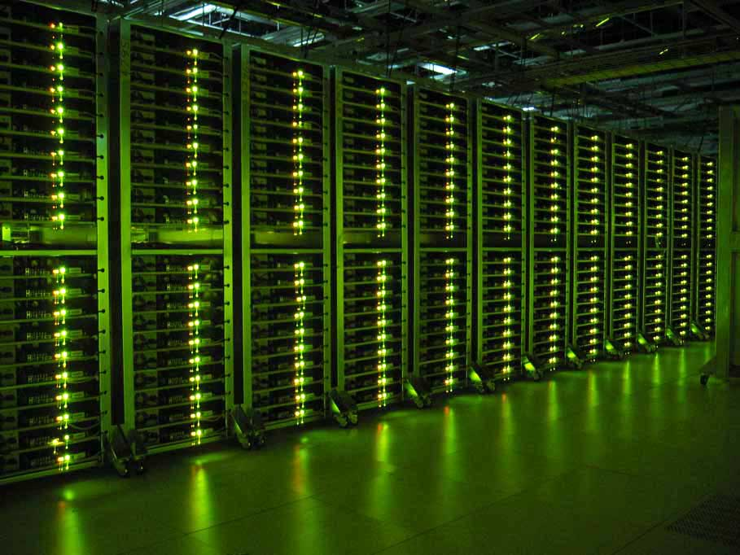
Algorithms in online interaction
Lana Cagle
The primary ways we interact with the internet have a level of separation between the user and the content delivered
YouTube[1], TikTok[2], Spotify[3], Google Search[4], and others use recommendation algorithms
These algorithms have uncontrollable mechanisms deciding results
Google’s server racks [8]
Notes:
No matter what you are using the internet for, be that using a search engine, scrolling a social media, or scrolling through a streaming service, the things you’re seeing are being served to you by content recommendation algorithms. YouTube, Spotify, Google Search, Netflix, and countless others utilize these algorithms. In some way, they are inescapable– there is a lot of content out there, and only so much of it is relevant and can be shown reasonably at once. However, these systems also have factors which remain outside of human control.

Slide 14
Defining content-serving algorithms
Lana Cagle
Machine-learning systems sort and prioritize content
Content varies by implementation– can be search results, media recommendations, etc.
Result Scoring & Gradient Descent [1]
Black boxes
Notes:
First, let’s define what a Content-Serving Algorithm is. These are programs which utilize machine-learning systems, or “neural networks,” in order to sort and prioritize content. What exactly the “content” is varies by implementation and use. It could be web queries, posts, or any other form of media. These systems automatically score a post on some metric of success based on interaction with the user, usually defined by factors such as click-through rates and user retention. The quality of outcome is then added to the database and tied to a complex network of nodes which store information that categorizes posts and users, and through a math process called “Gradient Descent” works its way towards better and better scores. These systems are “black boxes,” as the way networks create these categorizations can not be cleanly understood by a human observer, even with access to the inner workings of the program.

Slide 15
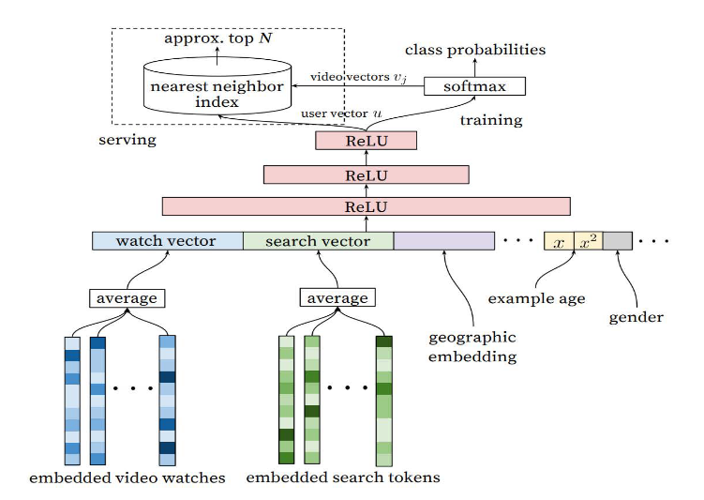
Example: youtube
Lana Cagle
Content recommendation algorithm
Controls videos shown in home feed, recommended, autoplayed, and in most other feeds (including subscriptions)[1]
Videos scored by “watch time” and “click-through rate” [1]
“Successful interactions” added to database, tied to both user and video [1]
Diagram depicting example of mechanisms in recommendations [1]
Notes:
One prominent example of these algorithms being deployed is YouTube. A content-recommendation algorithm handles every video which pops up on your home feed, the recommended videos while already watching another, the autoplayed content, search results, and even your subscriptions feed. Every video is scored based on user-interaction metrics of “watch-time” and “click-through rate,” factoring in both specific interactions with that post as well as interactions with posts similar to it. These “successful interactions” (interactions where a user clicks and especially remains watching a video, or autoplays to another) are then added back into YouTube’s gigantic database and fed back into the network.

Slide 16
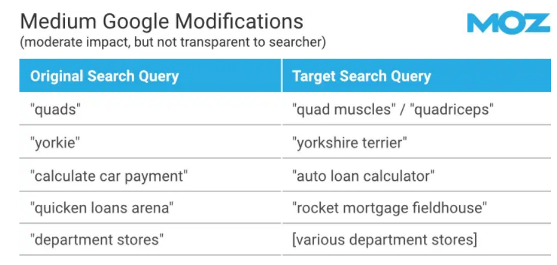
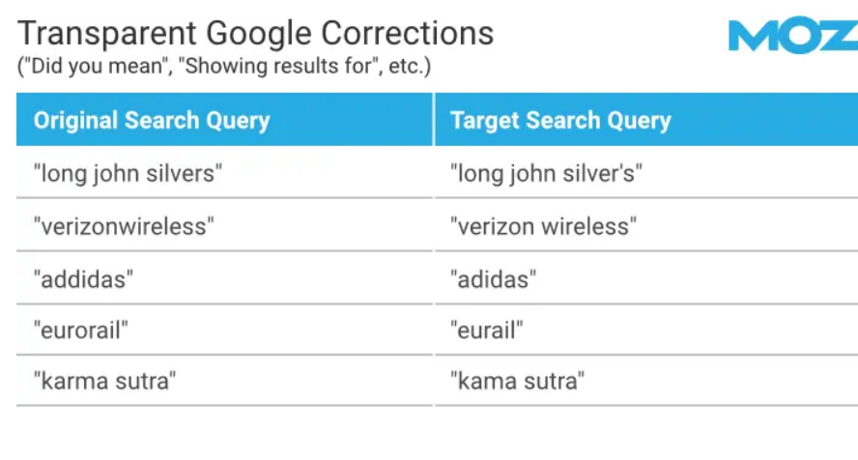
Lack of control
Lana Cagle
Machine-learning algorithms have factors which cannot be perfectly quantified by humans [1]
Common UX features such as autoplay remove control from users [1][2]
Services can modify inputs without informing users [4]
Example search query changes [4]
Notes:
These algorithms inherently have some level of uncontrollability due to their black box nature, as discussed before. However, the ways users engage with these algorithms can be manipulated beyond the end user’s control, as well. Common User Experience/Interface features, such as by-default-enabled autoplay, remove a level of user consent when engaging with these platforms; by simply engaging with one piece of content on the platform, you are considered consenting to the algorithmically determined next piece of content unless specifically telling the system otherwise. Services can also modify user inputs both transparently and behind the scenes, showcased by these displayed and hidden query modifications in Google Search.

Slide 17
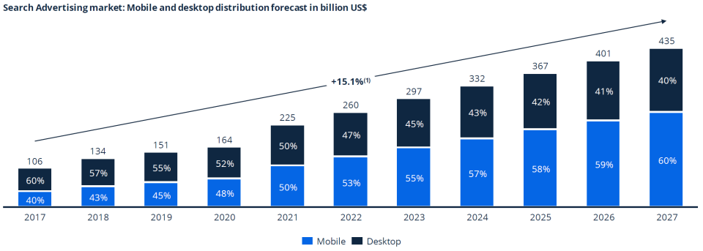
Consequences in interaction
Lana Cagle
Content served on platforms with these systems is optimized for engagement [1][2][5]
These optimizations can lead to addiction, showcased by prevalent addictive effects of TikTok [2]
Users adjust around algorithms, for better and for worse [5][6]
Search Engine Optimization has become an industry [7]
SEO market growth in desktop and mobile distributions [9]
Notes:
When content is being served using these algorithms, they are being optimized for engagement. It’s simply the way these companies make money; engagement puts eyes on ads which puts money in the hands of service providers. However, this incentivizes providers to get users as engaged as possible, leading to cases of addiction in precise enough algorithms, such as that of TikTok’s short-form video platform. Beyond this, users also change their behaviors around these systems. Sometimes this is harmless: TikTok users replace words such as “kill” with “unalive” and users in general work to optimize the content they create to mesh with the algorithm, a common experience particularly on YouTube, where major algorithm changes have resulted in major changes in who and what is popular. Sometimes, this also leads to situations like SEO methods being used to manipulate search queries during the 2016 Congressional Elections.

Slide 18
conclusions
Lana Cagle
The core ways content is delivered online changes user behavior. This is utilized by service providers and end users alike.
Content recommendation algorithms result in mass data collection, addiction, and users being pushed towards extremism
Algorithms used for this purpose need to be used with transparency and allow for direct user control

Slide 19
References
Lana Cagle
[1] Lauren Valentino Bryant, The YouTube Algorithm and the Alt-Right Filter Bubble, Open Information Science (June 8, 2020), https://doi.org/10.1515/opis-2020-0007, April 28, 2024
[2] Yao Qin, Bahiya Omar, Alessandro Musetti, The addiction behavior of short-form video app TikTok: The information quality and system quality perspective, Frontiers in Psychology (September 5, 2022), https://www.frontiersin.org/journals/psychology/articles/10.3389/fpsyg.2022.932805/full, April 28, 2024
[3] Ashton Anderson, Lucas Maystre, Ian Anderson, Rishabh Mehrotra, Mounia Lalmas, Algorithmic Effects on the Diversity of Consumption on Spotify, Association for Computing Machinery (April 2020), https://doi.org/10.1145/3366423.3380281, April 28, 2024
[4] Dr. Peter J. Meyers, How Google Changes Your Searches (A Study of 10,000 Queries), MOZ (November 1, 2023), https://moz.com/blog/google-modifying-searches#minor-modifications-(without-notice), April 28, 2024
[5] Ignacio Siles and Ariana Meléndez-Moran, The most aggressive of algorithms”: User awareness of and attachment to TikTok’s content personalization, University of Costa Rica (May 27, 2021), https://hdl.handle.net/10669/83230, April 28, 2024
[6] Panagiotis Takis Metaxas and Yada Pruksachatkun, Manipulation of Search Engine Results during the 2016 US Congressional Elections, Proceedings of the ICIW (2017), https://cs.wellesley.edu/~pmetaxas/Metaxas-Search-Engine-Manipulation-US-Elections-2016.pdf, April 29, 2024
[7] Himanshu Matta, Dr. Ruchika Gupta, Dr. Sumit Agarwal, Search Engine optimization in Digital Marketing: Present Scenario and Future Scope, IEEE (2017), https://ieeexplore.ieee.org/abstract/document/9160016, April 29, 2024
[8] Rich Miller, A Glimpse Inside Google’s Data Centers, DataCenter Knowledge (May 22, 2012), https://www.datacenterknowledge.com/archives/2012/05/22/a-glimpse-inside-googles-data-centers, April 29, 2024
[9] James Bledsoe, Search Engine Optimization Drives Online Sales, International Trade Administration, https://www.trade.gov/how-does-search-engine-optimization-work, April 29, 2024

Slide 20
Stigma in the defense Industry
Elizabeth Levin

Slide 21
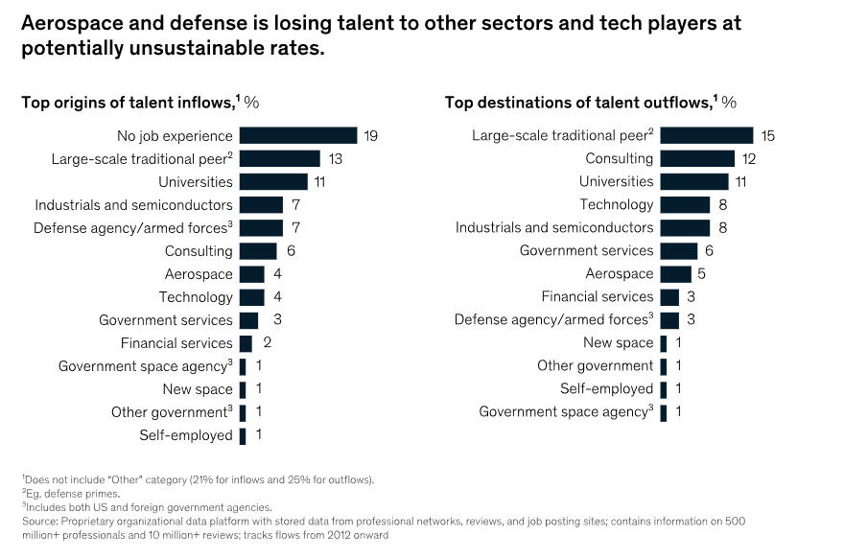
Decline of defense positions
Elizabeth Levin
“Air Force’s core acquisition staff has fallen 35 percent to 40 percent over the last 14 years”[1]
[2]
Notes:
Defense agencies are close to the bottom of talent outflows, compared to other industries

Slide 22
Examples of Ethical Issues In Defense Companies
Elizabeth Levin
Notes:
Introduction to problems with the industry.

Slide 23

General Dynamics
Elizabeth Levin
General Dynamics asked to prepare human rights report for their weapons manufacturing [3]
Board of Directors unanimously recommended to vote against the proposal [3]
Their defense was that they only made the bombs, and that the unethical decisions were made by the U.S Government who used their weapons [3]
Upsetting their top customer would negatively affect their shareholder values [3]
Notes:
Proposal was “on General Dynamics Corporation’s human rights due diligence process to identify, assess, prevent, mitigate, and remedy actual and potential human rights impacts associated with high-risk products and services, including those in conflict-affected areas”
Even though the government calls the shots in the end, contractors should still be responsible for performing their own human rights analysis.

Slide 24
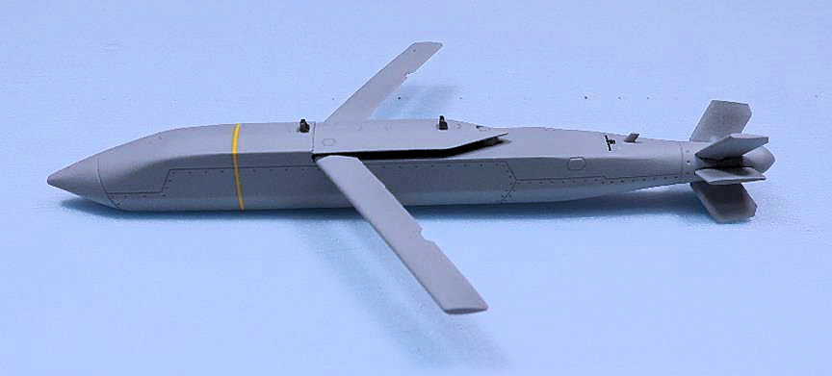

Raytheon Production of JSOW
Elizabeth Levin
The Joint Standoff Weapon is a delivery system for cluster bombs [4]
Cluster bombs are deemed illegal in over 100 countries due to high probability of collateral. [4]
[5]
[6]
Notes:
Cluster bomb is essentially many smaller explosives loaded into a missile. The missile opens up mid air and the bombs ignite as they fall, exploding above the ground [6].
Picture on the right is the left over debree from these weapons.
Many don’t want to have a part in developing systems like this

Slide 25
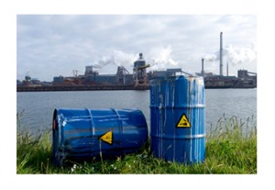
Raytheon Toxic Chemicals
Elizabeth Levin
Raytheon has accumulated 90 federal lawsuits for failing to clean up tainted soil from the 1990s [7]
Sent tainted water to 50,000 people in Arizona [7]
Multiple times at different sites, Raytheon refused to take responsibility for cleanup [7]
Contamination from previous Raytheon sites continues to be an issue [8]
Notes:
Mention personal story about finding thing in the forest being an ex Raytheon site:
Im from Sudbury, a town neighboring wayland that also had a Raytheon laboratory. It was turned into a shopping plaza. However, you can still find old
Raytheon parts and garbage in the woods behind one of the stores.
Talk about contamination issues in Wayland:
Wayland mass used to be a massive Raytheon complex during the cold war.
Raytheon has been doing clean up in wayland since 1995, and is still remedying to this day.

Slide 26
So Is working for defense unethical?
Elizabeth Levin
Well not exactly…
Notes:
Introduce the good that comes from military innovation.

Slide 27
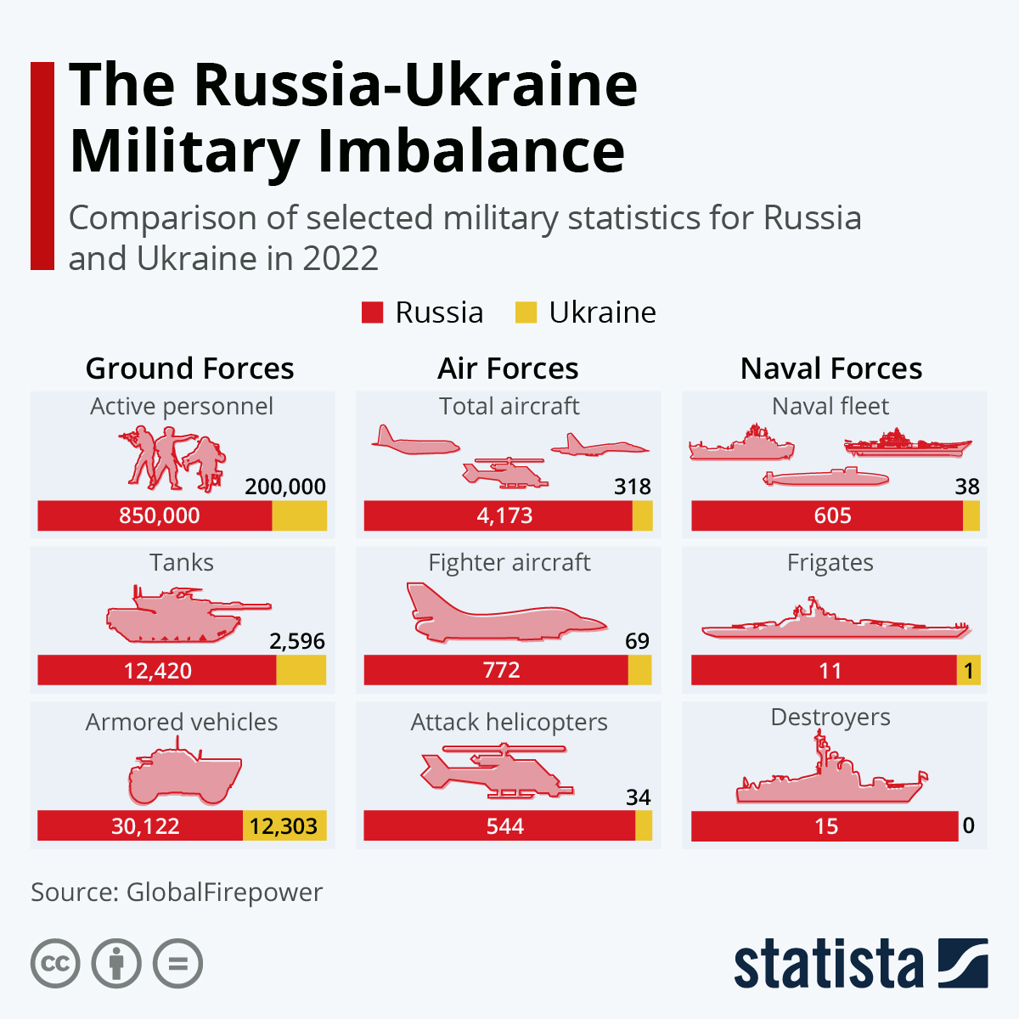
Ukraine Drones
Elizabeth Levin
Ukraine is able to stand a chance against Russian invasion thanks to development of drone technology [9]
Drones can be developed cheaply, and allow attack from a distance [9]
[10]
Notes:
Drones completely changed landscape of modern warfare, as Russia and Ukraine race to innovate the next drone and drone jammers.
The Russian military greatly outnumbers Ukraine with recourses and man power, but Ukraine is still fighting this war to this very day.

Slide 28

Israel Iron Dome
Elizabeth Levin
The Israel Iron dome has intercepted thousands of rockets fired from the Gaza strip [11]
It has a 90 - 97% success rate, saving countless lives [11]
Iron dome intercepts missiles from Gaza over the sky of Ashkelon [12]
Notes:
Mention personal story about seeing the iron dome shoot down missiles
Israel is very often at war with neighboring countries, and the Iron dome ensures that people can still live safely within the country.

Slide 29
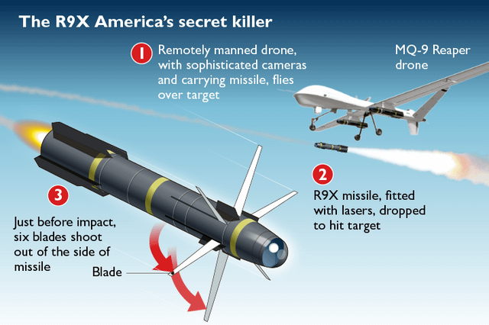
Lockheed Martin Hellfire R9X
Elizabeth Levin
Old versions of this missile has danger zone of 700-foot radius [13]
New version has danger zone of 30 inch radius [13]
Missile uses long blades instead of an explosion [13]
In 2022, Leader of al-Qaeda was killed by U.S while standing on balcony in crowded city, no collateral damage [13]
Notes:
Talk about how missile opens knives just before impact, allowing a deadly impact in a very small radius.

Slide 30
Conclusion
Elizabeth Levin
Unfortunately, death is a part of war
Removing yourself from the problem does not solve it
You can help by choosing to contribute to projects that decrease the risk of collateral casualties.
Notes:
In an idealistic world, there would be no war. But unfortunately that is not the reality.
Talk about how the claim “Not working for a defense company” does not make you a more ethical person.
If people who were concerned about human rights refuse to get involved in the defense industry, then who does that leave to work there? Maybe people who might care less about human rights.

Slide 31
References
Elizabeth Levin
*Most recent access for all: Apr 30, 2024
[1] Taubman, P. (2008, June 25). Top engineers shun military; concern grows. The New York Times. https://www.nytimes.com/2008/06/25/us/25engineer.html
[2] L., A. (2023, May 31). The software talent gap in aerospace & defense. Talent Partners. https://talentpartnersinc.com/talent-gap-in-aerospace/
[3]https://s22.q4cdn.com/891946778/files/doc_financials/2021/ar/General-Dynamics_2022-Proxy-Statement.pdf
[4] Raytheon: Corporate rap sheet. Good Jobs First. (2012, September 23). https://www.corp-research.org/raytheon
[5] AGM-154C1 Block II joint stand-off weapon. IPMS/USA Reviews. (2018, June 30). https://reviews.ipmsusa.org/review/agm-154c1-block-ii-joint-stand-weapon
[6] Cluster Munition Coalition. What is a Cluster Bomb? | Cluster bombs | CMC. (n.d.). https://www.stopclustermunitions.org/en-gb/cluster-bombs/what-is-a-cluster-bomb.aspx
[7] Dunn, A. (2019, December 7). Raytheon spotty on cleanup. Tampa Bay Times. https://www.tampabay.com/archive/2008/08/20/raytheon-spotty-on-cleanup/
[8] Former Raytheon Facility Contamination Letter. wayland ma. (2006, July 24). https://www.wayland.ma.us/sites/g/files/vyhlif9231/f/uploads/former_raytheon_facility_contamination_letter.pdf

Slide 32
References Cont
Elizabeth Levin
*Most recent access for all: Apr 30, 2024
[9] Burgess, M. (2022, May 6). Small drones are giving Ukraine an unprecedented edge. Wired. https://www.wired.com/story/drones-russia-ukraine-war/
[10] 26, A. (2024, April 26). Russia vs Ukraine military comparison 2024. Statista. https://www.statista.com/statistics/1296573/russia-ukraine-military-comparison/#:~:text=Russia’s%20military%20capabilities%20outnumbered%20those,7.5%20times%20larger%20than%20Ukraine’s
[11] MacDiarmid, C. (2021, May 12). How Hamas pierced Israel’s famous Iron Dome Shield. The Telegraph. https://www.telegraph.co.uk/news/2021/05/12/hamas-pierced-israels-famous-iron-dome-shield/
[12] Frankel, J. (2023, October 24). Is Israel’s Iron Dome Missile Defense System Ironclad? AP News. https://apnews.com/article/iron-dome-missile-defense-israel-palestinians-rockets-hamas-f57508d0e53945d1071d4582fcdae8d2
[13] McKay, H. (2023, October 25). Behind america’s secret “ninja knife bomb” used to kill terrorists while leaving everything around them untouched. Behind America’s secret “ninja knife bomb” used to kill terrorists while leaving everything around them untouched. https://holliesmckay.substack.com/p/behind-americas-secret-ninja-knife

Slide 33
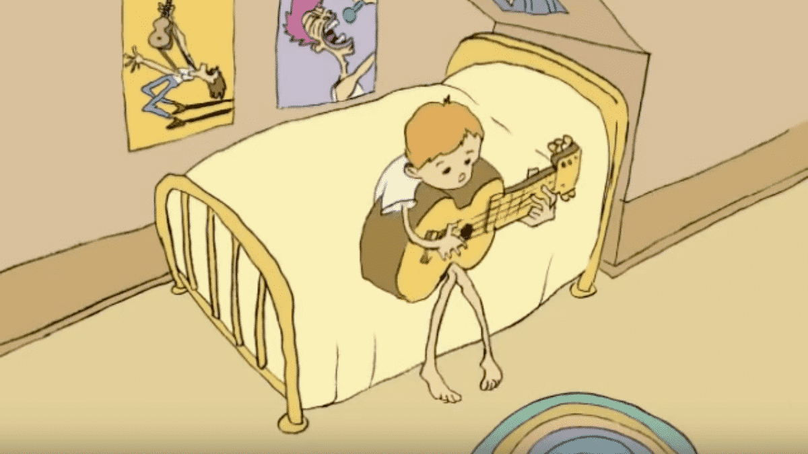


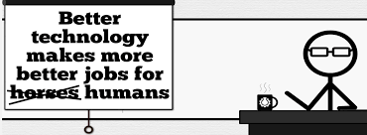




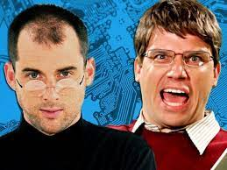

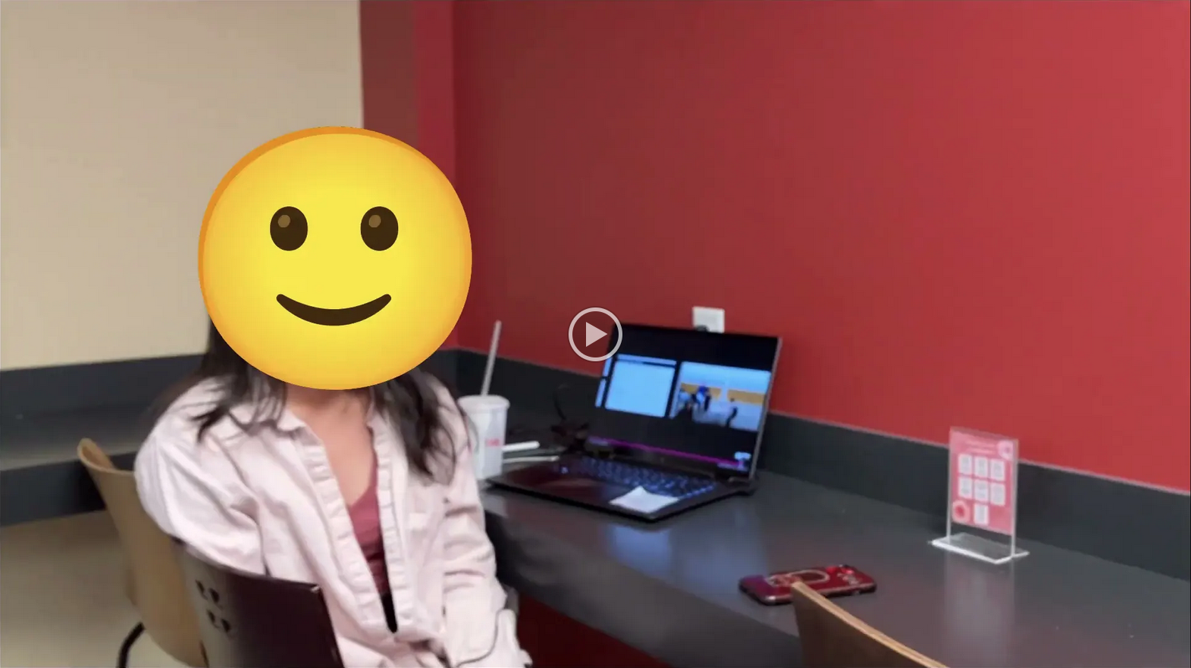
Student Choice – Interesting Videos (1/2)
Don’t Download This Song (2006)
- Weird Al (3:53)
It’s All About The Pentiums (1999)
- Weird Al (3:34)
White and Nerdy (2006)
- Weird Al (2:50)
Virus Alert (2006)
- Weird Al (3:43)
Word Crimes (2014)
- Weird Al (3:45)
Copyright: Forever Less One Day (2011)
- CGP Grey (6:27)
Humans Need Not Apply (2014)
- CGP Grey (15:00)
This Video Will Make You Angry (2015)
- CGP Grey (7:25)
Technologic (2005). ← Which topic?
- Daft Punk (2:55)
Epic Rap Battles of History: Steve Jobs vs. Bill Gates (2013) (2:47)
Passwords (2024) ← Compare
- Elizabeth Levin, Silas Joy (WPI CS3043) (5:37)
© 2023 Keith A. Pray
Notes:
Technologic: Critical Thinking, Ethics, Networked Communications, Information Privacy, Reliability, Professional Ethics?
David Autor Will automation take away all our jobs? (18:27) (2016) https://www.ted.com/talks/david_autor_will_automation_take_away_all_our_jobs/transcript?language=en TEDxXambridge, 2016-12-19
All Last Accessed 2018-10-04
CGP Grey
Copyright: Forever Less One Day (6:27)
https://www.youtube.com/watch?v=tk862BbjWx4
CGP Grey
Humans Need Not Apply (15:00) – 2014-08-13
http://www.youtube.com/watch?v=7Pq-S557XQU
Last access 2016-04-22
CPG Grey This Video Will Make You Angry [Thought Germs] (7:25) – 2015-03-10
https://www.youtube.com/watch?v=rE3j_RHkqJc
Weird Al – It’s All About The Pentiums (3:34)
https://www.youtube.com/watch?v=qpMvS1Q1sos
TODO: Tie into Ray Kurzweil Singularity
Epic Rap Battles of History: Steve Jobs vs. Bill Gates (If class ok with obscene lyrics) (2:47)
https://www.youtube.com/watch?v=njos57IJf-0
Also Work links on web site http://socialimps.keithpray.net/documents/
-----
Passphrases (2:08 need to give context for video)
https://firstlook.org/theintercept/2015/03/26/passphrases-can-memorize-attackers-cant-guess/
If not shown during first class
What "Orwellian" really means - Noah Tavlin (5:31)
http://ed.ted.com/lessons/what-orwellian-really-means-noah-tavlin
Weird Al – White and Nerdy (2:50) and look at lyrics
https://www.youtube.com/watch?v=N9qYF9DZPdw
Weird Al Yankovic “Don’t Download This Song” (3:53) 2006-08-21 released exclusively as digital download
https://www.youtube.com/watch?v=zGM8PT1eAvY
Styx - Mr. Roboto (1983) (5:34) https://www.youtube.com/watch?v=uc6f_2nPSX8
Epic Rap Battles of History: Steve Jobs vs. Bill Gates (If class ok with crude lyrics) (2:47)
https://www.youtube.com/watch?v=njos57IJf-0
Daft Punk - Technologic (2005) (2:55)
https://www.youtube.com/watch?v=D8K90hX4PrE

Slide 34


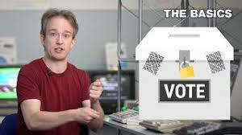








Student Choice – Interesting Videos (2/2)
MSNBC on Denver's Automated Baggage System (2010) (2:27)
Last Week tonight with John Oliver (2015) - Snowden (33:14)
3D Printed Homes (2018)
- News Story (1:28)
The Game Of Trust (2017) - Nicky Case
Adobe Firefly (2023) - Adobe (1:16)
What "Orwellian" really means (2015) - Noah Tavlin (5:31)
Why Electronic Voting is Still a Bad Idea (2019) - Tom Scott (12:00)
Welcome To Life (2012) - Tom Scott (2:44)
Mr. Roboto (1983)
- Styx (5:34)
Will automation take away all our jobs? (2016) – David Autor (18:27)
What is your password? (2015)
- Jimmy Kimmel Live (2:49)
© 2023 Keith A. Pray
Notes:
All Last Accessed 2018-10-04 unless publish date later
Last Week tonight with John Oliver – Patriot Act, Edward Snowden (33:14)
http://www.upworthy.com/john-oliver-flew-10-hours-to-russia-to-interview-edward-snowden-and-get-him-on-record?c=ufb1
TODO: Tie into Ray Kurzweil Singularity
Epic Rap Battles of History: Steve Jobs vs. Bill Gates (If class ok with obscene lyrics) (2:47)
https://www.youtube.com/watch?v=njos57IJf-0
Also Work links on web site http://socialimps.keithpray.net/documents/
-----
Passphrases (2:08 need to give context for video)
https://firstlook.org/theintercept/2015/03/26/passphrases-can-memorize-attackers-cant-guess/
If not shown during first class
What "Orwellian" really means - Noah Tavlin (5:31)
http://ed.ted.com/lessons/what-orwellian-really-means-noah-tavlin
MSNBC on Denver's Automated Baggage System 2010-08-23 (2:27)
https://www.youtube.com/watch?v=xx8f4x6C_KY
Accessed 2019-04-09
These 3D printed homes can be constructed for $4,000 (3:00 – 2018-04-02)
http://www.businessinsider.com/3d-printed-homes-constructed-icon-new-story-tech-charity-4000-dollars-2018-3
https://www.youtube.com/watch?v=SvM7jFZGAec (1:28)
Last access 2018-04-22
Why Electronic Voting is a BAD Idea – Computerphile (Tom Scott) (8:20)
https://www.youtube.com/watch?v=w3_0x6oaDmI
Tom Scott
http://tomscott.com
Welcome To Life (2:44)
https://www.youtube.com/watch?v=IFe9wiDfb0E&feature=youtu.be
Jimmy Kimmel Live – What is your password? (2:49)
https://www.youtube.com/watch?v=opRMrEfAIiI

Slide 35

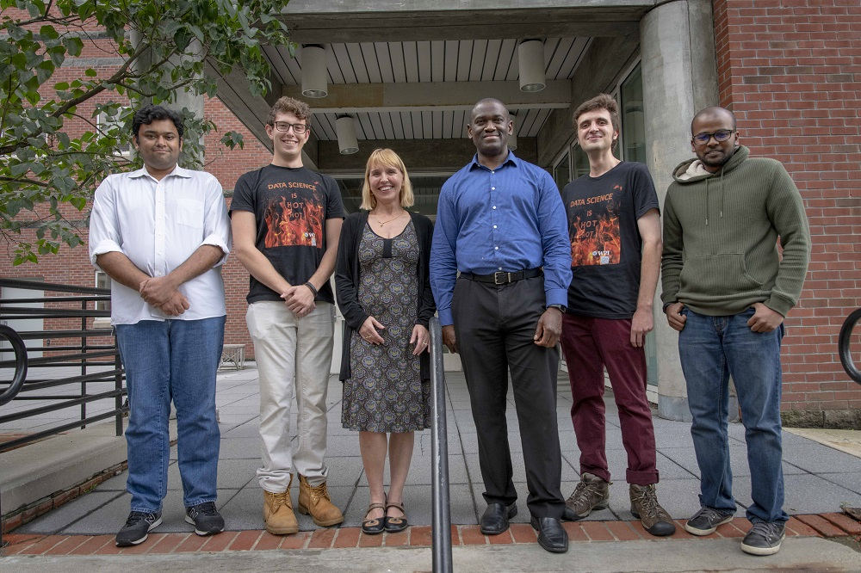

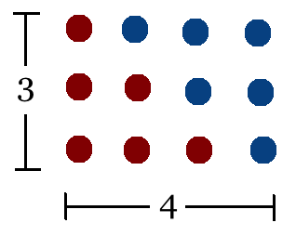
Student Choice – Interesting Articles 1/2
Communications of The ACM – Latest edition (through library)
Facebook security breach: Up to 50m accounts attacked - Dave Lee, North America technology reporter, 2018-09-29
WPI Secures $2.8 Million to Develop a Smartphone App to Help Assess the Health of Soldiers, 2018-09-24
Quantified Toilets, 2014, Quantified Toilets LLC (empty) What a Toilet Hoax Can Tell Us About the Future of Surveillance – Jennifer Golbeck, The Atlantic, 2014-04-29
What Did Ada Lovelace's Program Actually Do? - Sinclair Target, 2018-08-18 (First Programming Bug 1843?)
Notes:
All Last Accessed 2021-04-03

Slide 36
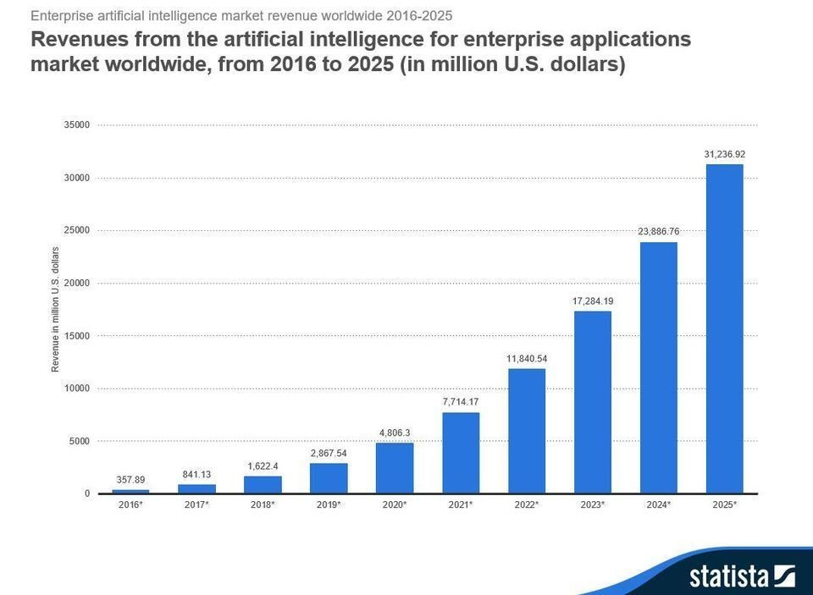
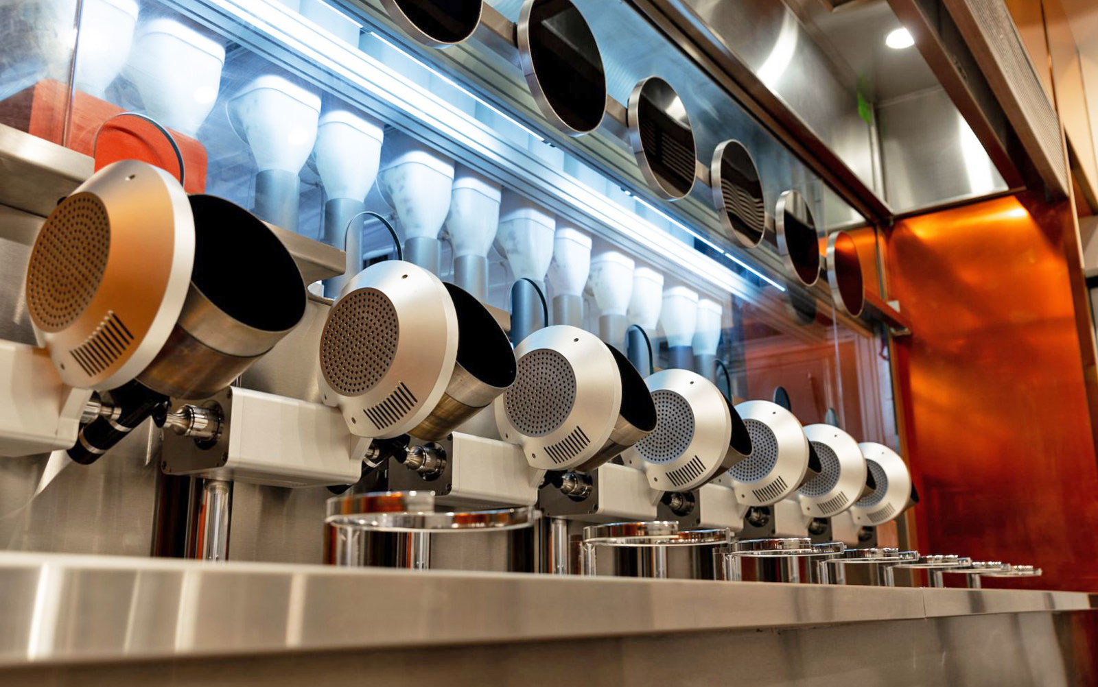

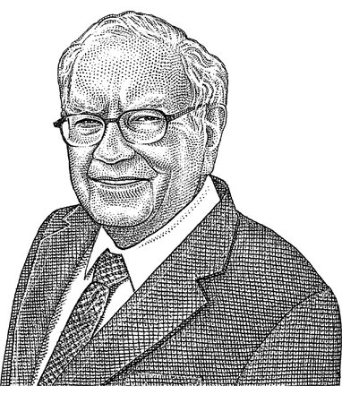
Student Choice – Interesting Articles 2/2
We know ethics should inform AI. But which ethics? - Mauro Guillen, World Economic Forum, 2018-07-26
MIT-born Spyce raises $21M to open new robotic restaurants - Lucia Maffei, BostInno, 2018-09-07
The Coders Programming Themselves Out of a Job - Brian Merchant, The Atlantic, 2018-10-02
Berkshire Hathaway’s Stock Price Is Too Much for Computers - Alexander Osipovich, The Wall Street Journal, 2021-05-05 (approaching $429,496.7295 32 bit limit) (access limited)
Notes:
All Last Accessed 2021-04-03
Spyce image: https://www.engadget.com/2018/05/04/boston-robotic-kitchen-spyce/ , 2018-05-04
Coders Programming Themselves Out of a Job image: Gabrielle Lurie, Reuters (date unknown)

Slide 37
Class 12-14 The End
Keith A. Pray
socialimps.keithpray.net

