Slide 1
Class 6
Information Privacy
Keith A. Pray
socialimps.keithpray.net
Notes:
How is the self search paper going? Offer small group discussion instead of class wide.
Who: found a lot, very little, surprised, not surprised, creepy, share conclusions

Slide 2
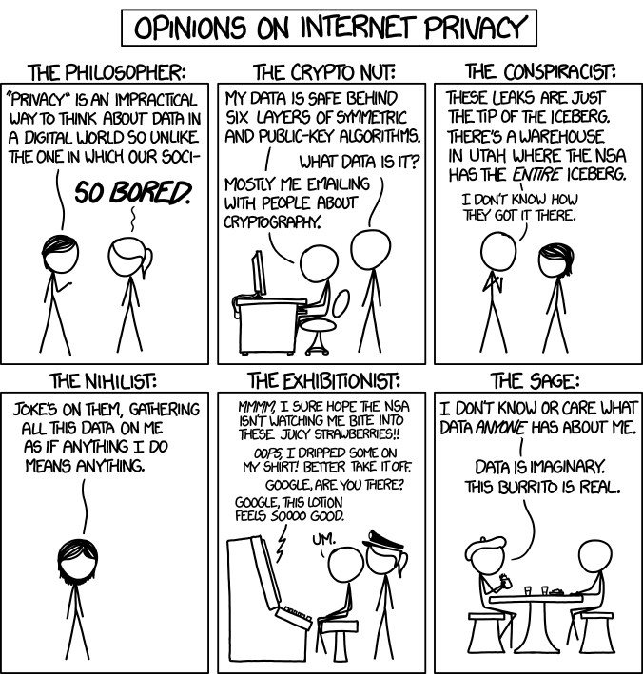

Overview
Review
Assignment
Students Present
http://xkcd.com/1269/
Notes:
1 – Accessed 2014-04-14
Everyone pick the category they identify most with.
Share reasons why.
Jimmy Kimmel Live – What is your password? (2:49)
https://www.youtube.com/watch?v=opRMrEfAIiI
Find out what your DNA says about you and your family.
https://www.23andme.com/
https://motherboard.vice.com/en_us/article/xwkaz3/23andme-sold-access-to-your-dna-library-to-big-pharma-but-you-can-opt-out?utm_source=vicefbus

Slide 3
My Reading Notes
pp. 234 Alexa calling unbeknown scary
pp. 235 How much do you use computer labs now?
pp. 236 Park example, videotape unlikely, Panopticon, businesswoman nice change
pp. 237 “moral capital” Book 1984 relationship == subversive act, ex-spouses just above enemies?
pp. 239 tech price down privacy invasion up?
pp. 240 Hilton consent to pic being in book?
pp. 242 How common are internet connected home surveillance systems?
pp. Do you expect privacy in others’ homes?
pp. 244 Many daycares monitor, any studies yet?
pp. 245 junk mailers not using info well
pp. 246 Anything come of EPIC Facebook Tag Suggestions complaint?
pp. 247 Loyalty programs changed in 20 years?
pp. 248 Clothing body scans common 20 years later?
pp. 249 How common implanted chips now, sources from 2002, 2004, 2007, 2010?
pp. 251 Any OnStar listening in events since? How much do auto black boxes record now?
pp. 252 Does Tivo’s ad skip weaken time shifting fair use? Browsers, not Servers, put cookies on HDs
pp. 256 Target execs were not savvy before see pp. 308. 2012 source same year Target outed pregnant teen to parents.
pp. 257 500 mil more than US population
pp. 262 How many times has Zuckerberg been quoted saying “I know we can do better”?
pp. 263 Why did Apple not enforce policy of asking permission in the API?
pp. 265 10 hours > 1 page paper
Questions I liked: 30, 39
Notes:
Notes updated: 2023-04-04
OLD not incorporated yet:
pp. 229 means to end?
pp. 245 “…by 2015” did it happen?
pp. 250 why is bills – responsibility assumption flawed?

Slide 4
Assignment
Prepare for class debate:
National ban on facial recognition surveillance for law enforcement?
  Do background reading and decide “Yes” or “No”
  Come prepared with notes, facts, dates, high quality sources
  Optional One Page Paper on the topic, lowest paper grade will be dropped
Notes:
Morgan Lee write up 2021-09-13:
“Facial recognition technology has begun to see widespread adoption in modern law enforcement, with applications in physical & digital security, as well as identifying potential suspects. Critics of the technology argue that passive facial recognition technology violates privacy rights of individuals, while its proponents emphasize its positive uses in preventing and detecting crime. There are currently 12 state-level bills which propose limits or bans on the use of facial recognition technologies by government agencies, with several local bans (including ones in Boston, Brookline, and Cambridge) already in place. Should the United States implement a national ban on the use of facial recognition technology by law enforcement?”
Previous Debates:
Should law require you to use an official ID for Internet access?
Is a National ID System a good thing?

Slide 5
Overview
Review
Assignment
Students Present

Slide 6
IS Private Company Surveillance of Public Spaces Acceptable?
Arnav Sacheti

Slide 7
Public spaces have been neglected; now surveillance encroaches on our right to privacy
Arnav Sacheti
Notes:
Through this presentation I hope to convey and convince you that there is a lack of data privacy regulations concerning both private and public spaces, this lack of regulation has allowed for rampant data collection and tracking, encroaching on our privacy.

Slide 8
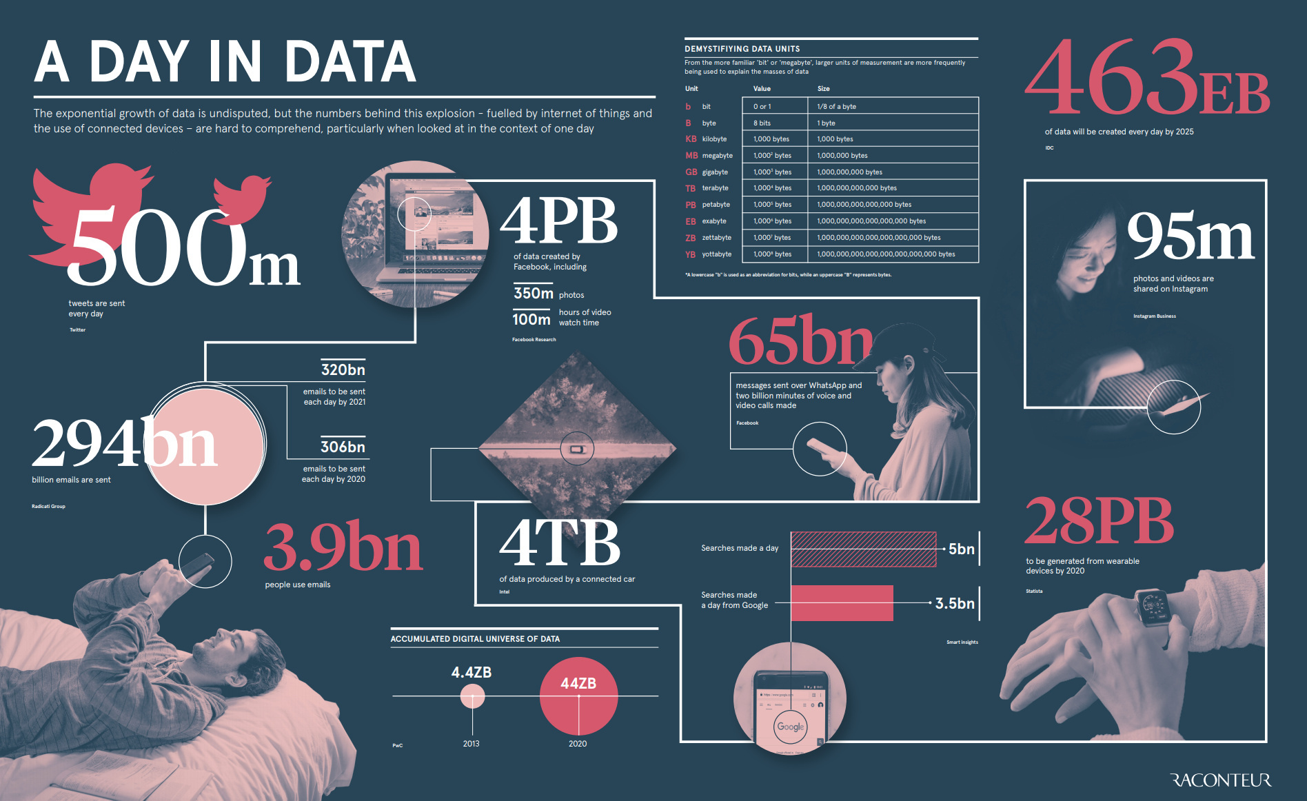
Data drives our world
Arnav Sacheti
Data from April 2019 ^{[12]}
Notes:
It is no secret that data is collected by everything, many of us in this room will at some point in our degree work with some sort of data.

Slide 9
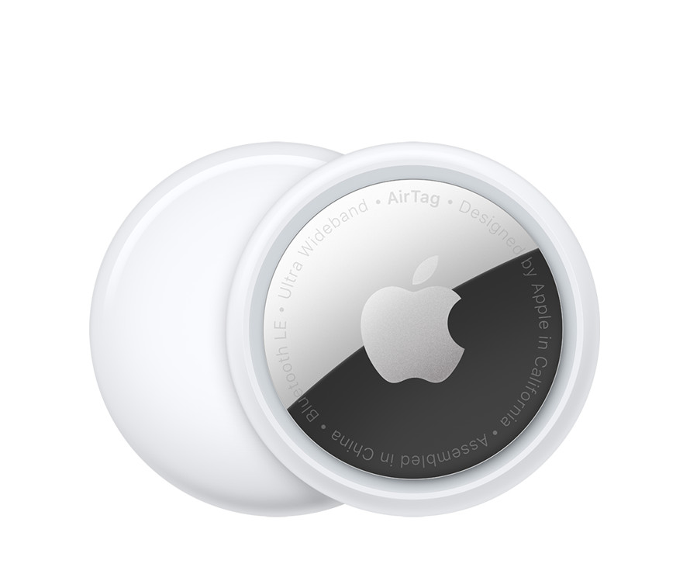
Digital Footprints aren’t local to computers
Arnav Sacheti
Passive Digital Footprint
Data collected without you doing anything
https://www.apple.com/shop/buy-airtag/airtag
Notes:
Airtags use this fundamental to keep your things safe. Passively send out some information regarding the tag, this happens while our iphones are continuously monitoring for this signal in the background. This all happens without the people whose phones detected the AirTag knowing about it.
Even with its small physical size, this device is constantly screaming for digital attention.

Slide 10
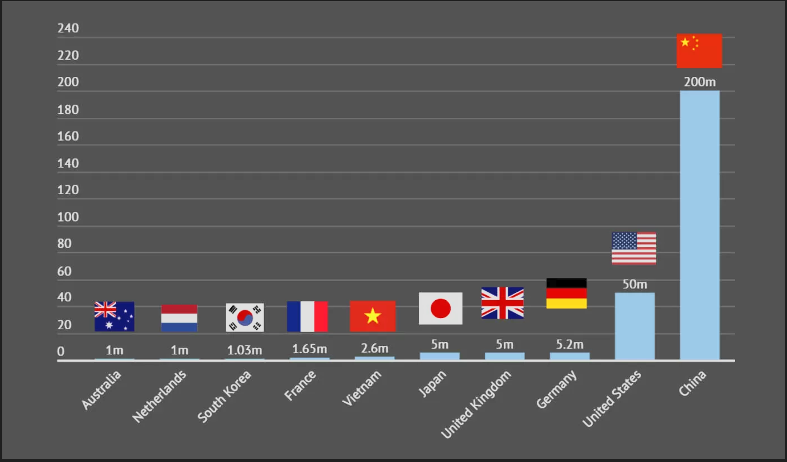
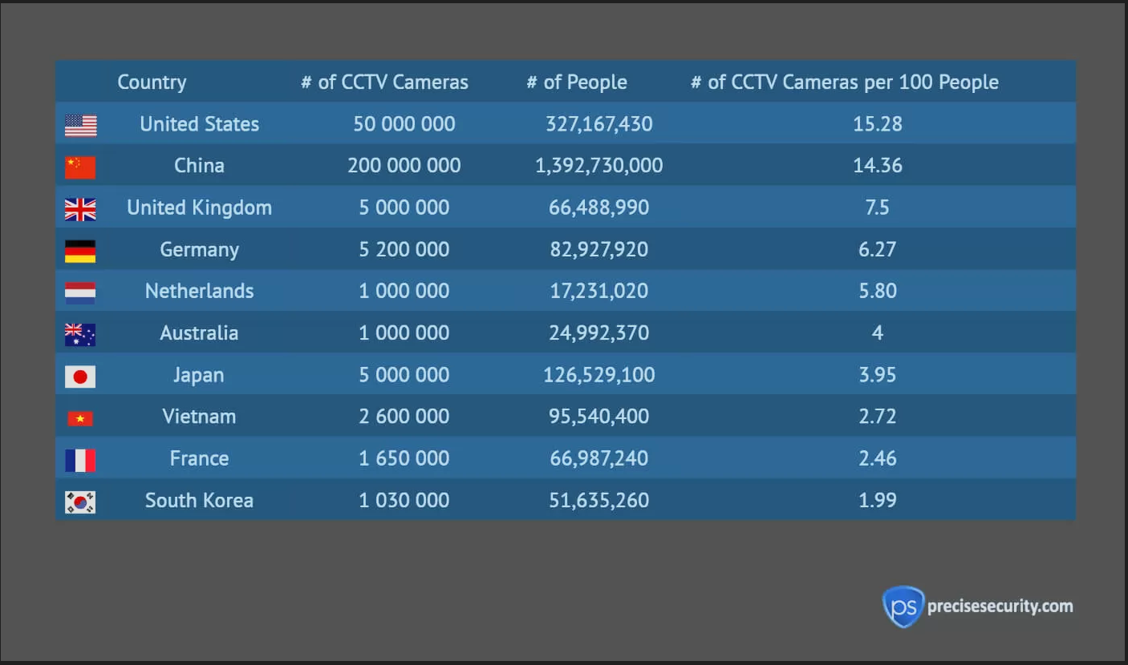
The US has a robust and capable surveillance network (1/2)
Arnav Sacheti
# of CCTV Cameras
Data from December 2019 ^{[8]}
Notes:
Typically when

Slide 11
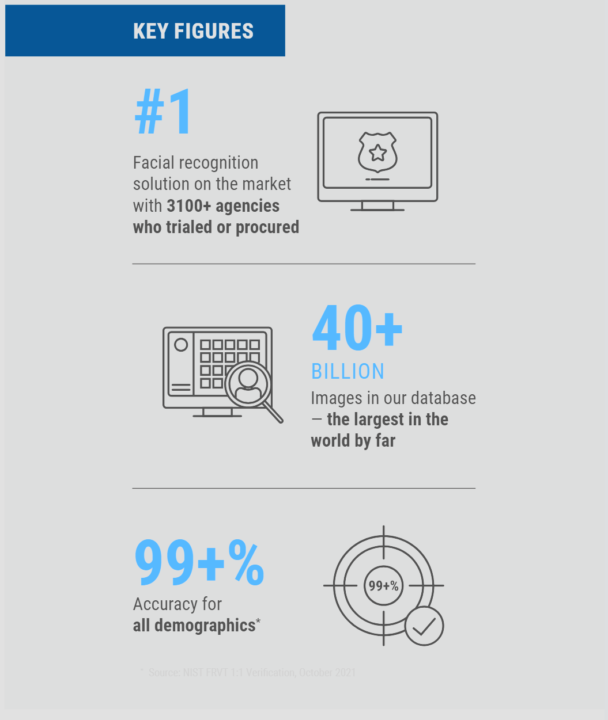
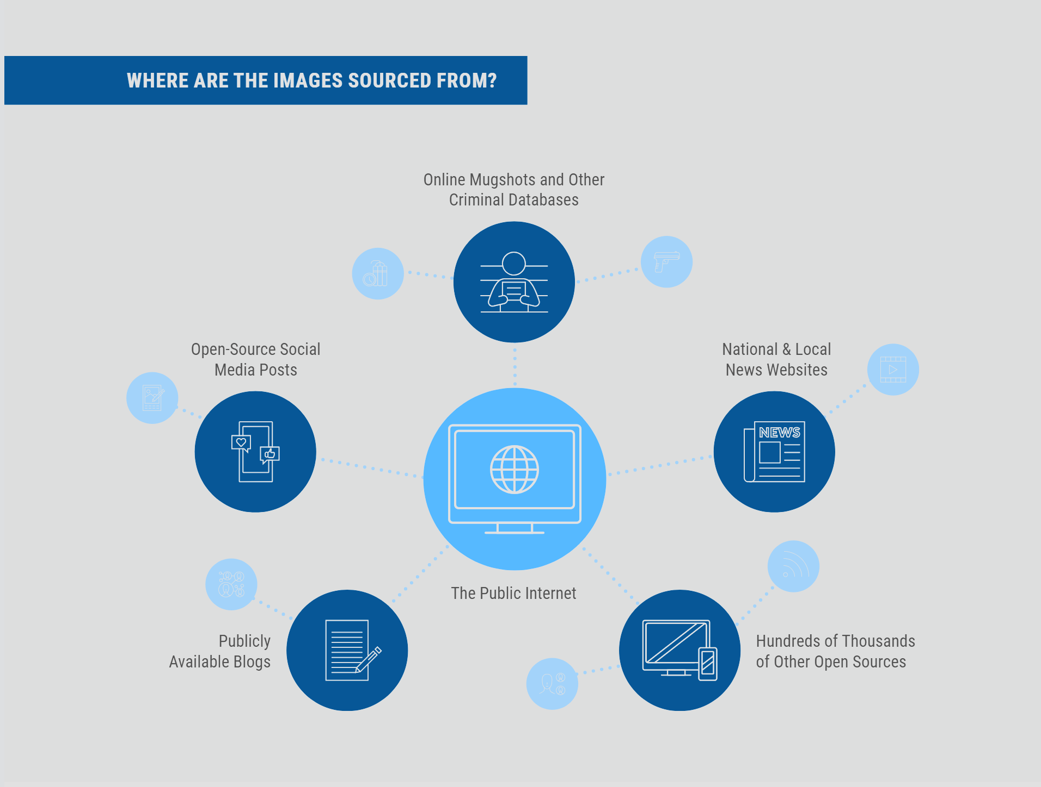
The US has a robust and capable surveillance network (2/2)
Arnav Sacheti
Data from April 2022 ^{[6]}
Notes:
Clearview AI, a controversial company, is in the business of monetizing public data to aid in police work. It is being used by over 600 law enforcement agencies as of May 2020 ^{[13]}. To prevent misuse they require one assigned administrator along with automated report and auditing^{[11]}.

Slide 12
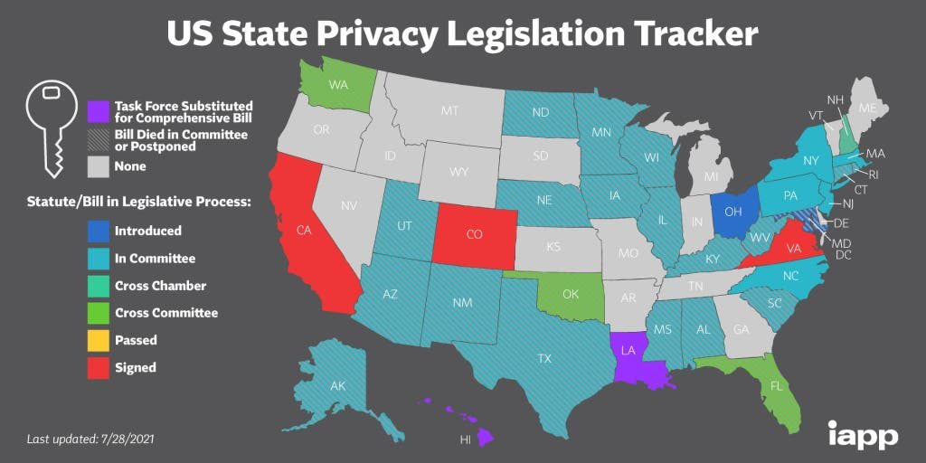
There is a lack of Regulation
Arnav Sacheti
2016 – Cuomo introduces “transformational plan to reimagine New York’s bridges and tunnels for [the] 21st century.” ^{[3]}
2017 – No Federal governing of Facial Recognition^{[3]}
2018 – California Consumer Privacy Act ^{[9]}
2022 – Boston announces community involvement ^{[7]}
Data from July 2021 ^{[14]}
Notes:
2017 – Lack of federal statute governing facial recognition, even more so lack of regulation regarding other types of dataveillance.
2018 – CCPA is adopted
2021 – still lacking legislature in majority of states, only 3 have signed laws
2022 – Boston passes ordinance that requires community control over police surveillance. Includes information about the technology, locations of use, purpose, mitigation plan for privacy and anonymity.

Slide 13
Even in Public you have the right to privacy
Arnav Sacheti
Katz v. U.S. (1967)
Case regarding if conversation in a closed phone booth is private
“Under Katz, the appropriate constitutional inquiry is whether people in contemporary American society have the reasonable expectation of privacy in identifying information about themselves even as they expose their faces to public view by leaving their homes and walking or driving down the street” ^{[3]}
Notes:
This case made clear that even though someone may be in public they still are not parading around sharing information, that means that that information is private and cannot be gleamed, hence “reasonable”. This can go further to things such as GPS tracking, while we can say that if someone is driving around town, they may be spotted while running errands, it is however unprobeable that someone of the public will constantly have knowledge of their movement without some scrutiny. . Private means warrant is needed. Even with this case creating a clear guideline set out by this case and others, we repeatedly see more and more surveillance under the guise of security.
More info regarding Katz v US:
Katz v. United States Case Brief Summary | Law Case Explained (youtube.com)
When Can We Expect Privacy? | Katz v. United States (youtube.com)

Slide 14
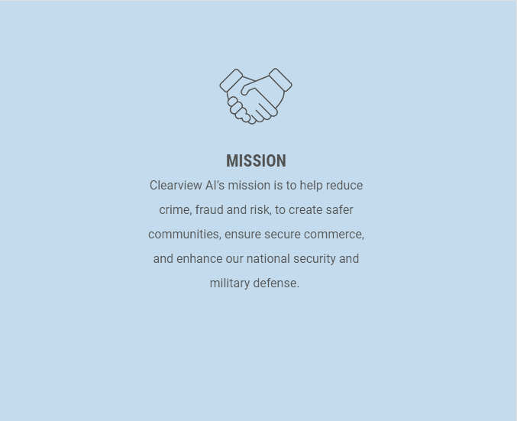
If you don’t have anything to hide, why do you care?
Arnav Sacheti
Geofeedia
Social Media based surveillance
Boston Police Department used this and was targeting minorities ^{[15]}
Clearview AI Mission Statement
Notes:
How many of us in the room at some point have made some immature joke that we did not know better about? How many have talked about some sensitive topic?
This technology is aimed at monitoring these conversations and then reporting them. BPD policy means that this can be shared with other law enforcement groups.

Slide 15
Is oversight enough to fix this?
Arnav Sacheti
Clearview AI touts its Administrative Oversight to prevent improper searches
"Police Misconduct Provision“ ^{[16]}
Title VI of the Civil Rights Act of 1964 and the "OJP Program Statute“ ^{[16]}
Title II of the Americans with Disabilities Act of 1990 and Section 504 of the Rehabilitation Act of 1973 ^{[16]}
Notes:
Laws in the US are often guided not as preventative measures, but instead as repentance mitigation; even then this get ignored. There will always be some rotten apple, from either side, who will want to misuse this technology, it is not a matter of if, but a matter of when.

Slide 16
We nEED better Privacy Regulation, Especially in public spaces
Arnav Sacheti
Notes:
Through this presentation I hope to convey and convince you that there is a lack of data privacy regulations concerning both private and public spaces, this lack of regulation has allowed for rampant data collection and tracking, encroaching on our privacy.

Slide 17
References
Arnav Sacheti
[1] Albert Fox Cahn, 20 Years After 9/11, Surveillance Has Become a Way of Life (WIRED, 9/11/2021), https://www.wired.com/story/20-years-after-911-surveillance-has-become-a-way-of-life/ (3/31/2024
[2] Laura Sydell, It Ain’t Me, Babe: Researchers Find Flaws In Police Facial Recognition Technology (NPR, 10/25/2016), https://www.npr.org/sections/alltechconsidered/2016/10/25/499176469/it-aint-me-babe-researchers-find-flaws-in-police-facial-recognition (3/31/2024)
[3] Mariko Hirose, Privacy in Public Spaces: The Reasonable Expectation of Privacy Against the Dragnet Use of Facial Recognition Technology (Connecticut Law Review, September 2017), https://digitalcommons.lib.uconn.edu/cgi/viewcontent.cgi?article=1376&context=law_review (3/31/2024)
[4] Roland Martin, Closed-Circuit Television (Britannica, 3/31/2024), https://www.britannica.com/technology/closed-circuit-television (3/31/2024)
[5] Catarina Fontes, AI-powered public surveillance systems: why we (might) need them and how we want them (Technology In Society, 11/9/2022), https://doi.org/10.1016/j.techsoc.2022.102137 (3/31/2024)
[6] Oleksandr Lytvnenko, Machine Learning Algorithms for Face Recognition (Code IT, 4/15/2022), https://codeit.us/blog/machine-learning-face-recognition (4/1/2024)
[7] Privacy SOS, Boston’s surveillance ordinance is set to go into effect in august. Here’s what you need to know. (Privacy SOS, 7/12/2022), https://privacysos.org/blog/bostons-surveillance-ordinance-is-set-to-go-into-effect-in-august-heres-what-you-need-to-know/ (3/31/2024)
[8] Humza Aamir, Report finds the US has the largest number of surveillance cameras per person in the world (TECHSPOT, 12/6/2019), https://www.techspot.com/news/83061-report-finds-us-has-largest-number-surveillance-cameras.html (4/1/2024)
[9] California Consumer Privacy Act (CCPA) (State of California Department of Justice, 3/13/2024), https://www.oag.ca.gov/privacy/ccpa#:~:text=The%20California%20Consumer%20Privacy%20Act%20of%202018%20%28CCPA%29,secures%20new%20privacy%20rights%20for%20California%20consumers%2C%20including%3A (4/1/2024)
[10] David Harrington, U.S. Privacy Laws: The Complete Guide (Varonis 9/2/2022), https://www.varonis.com/blog/us-privacy-laws (4/1/2024)
[11] Clearview AI, Building a Secure World, One Face at a Time (Clearview AI Resources), https://www.clearview.ai/resources (4/1/2024)
[12] Jeff Desjardins, How Much Data is Generated Each Day (Visual Capitalist, 4/15/2019), https://www.visualcapitalist.com/how-much-data-is-generated-each-day/ (4/1/2024)
[13] Rebecca Heilweil, The world’s scariest facial recognition company, explained (VOX, 5/8/2020) https://www.vox.com/recode/2020/2/11/21131991/clearview-ai-facial-recognition-database-law-enforcement (4/1/2024)
[14] Thorin Klosowski, The State of Consumer Data Privacy Laws in the US (And Why it Matters) (The NY Times, 8/6/2021) https://www.nytimes.com/wirecutter/blog/state-of-privacy-laws-in-us/ (4/1/2024)
[15] Nasser Eledroos and Kade Crockford, Social Media Monitoring in Boston: Free Speech in the Crosshairs (Privacy SOS, 2018), https://privacysos.org/social-media-monitoring-boston-free-speech-crosshairs/ (4/2/2024)
[16] DOJ, Addressing Police Misconduct Laws Enforce By the Department Of Justice (DOJ) https://www.justice.gov/crt/addressing-police-misconduct-laws-enforced-department-justice (4/2/2024)

Slide 18
Class 6
The End
Keith A. Pray
socialimps.keithpray.net
Notes:
This is the end. Any slides beyond this point are for answering questions that may arise but not needed in the main talk. Some slides may also be unfinished and are not needed but kept just in case.
If there’s time and we didn’t already look at:
Find out what your DNA says about you and your family.
https://www.23andme.com/
Jimmy Kimmel Live – What is your password? (2:49)
https://www.youtube.com/watch?v=opRMrEfAIiI

Slide 19
what works well Online With Zoom
Sign in with First and Last Name
Stay muted unless you are going to speak
To speak use the raise your hand feature
To answer yes/no questions use the “yes” ”no” buttons
Turn your camera on
Wait until the end of student presentations to ask questions
  Write them down so you don’t forget

Slide 20
Logistics
Address email to entire course staff for quickest response
Review Presentation and Paper Guidelines on course site
Notes:
Not needed this time:
Address email to entire course staff for quickest response time
Do not change the format, footers, etc. in the template slides.
Paper writing process: Sources → Notes → Conclusion → Argument → Counter Point → Response
Turn extra credit paper in on myWPI/Canvas and hard copy in class like regular papers
Use Presentation Guidelines on course web site
Use paper and presentation templates
Keep topics inside the course scope: Computing + Society
Presentations are due 24 hours before class
Sign up for Individual Presentation, it’s not too late

