Slide 1
Class 6
Information Privacy
Keith A. Pray
Instructor
socialimps.keithpray.net
Notes:
Here’s the title slide. Excited already, aren’t you?
How did the self search paper go? Offer small group discussion instead of class wide.
Who: found a lot, very little, surprised, not surprised, creepy, share conclusions

Slide 2
Logistics
Address email to entire course staff for quickest response time
Any course logistic questions?
Notes:
Not needed this time:
Address email to entire course staff for quickest response time
Send presentations via email as attachment.
Do not change the format, footers, etc. in the template slides.
Paper writing process: Sources → Notes → Conclusion → Argument → Counter Point → Response
Turn extra credit paper in on myWPI/Canvas and hard copy in class like regular papers
Presentations are due 24 hours before class
Use Presentation Guidelines on course web site

Slide 3
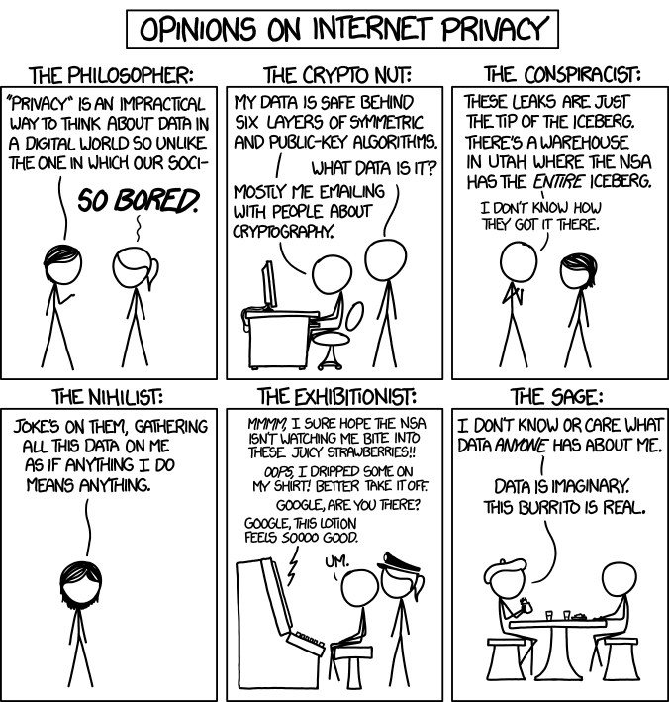
Overview
Review
Assignment
Students Present
http://xkcd.com/1269/
Notes:
1 – Accessed 2014-04-14

Slide 4
My Reading Notes
pp. 229 means to end?
pp. 230 who videotapes anymore?
pp. 231 “businesswoman” nice change. Moral capitol – source published in 1984, “taking away” “1984”
pp. 234 Hilton consent to pic being in book?
pp. 237 Many daycares monitor, any studies yet?
pp. 238 “…privacy…in their own homes…” != nanny to expect privacy “…when… insides Sullivans’ home.
pp. 244 Human chip implant sources getting old, 2002, 2004, 2007, 2010
pp. 250 2012 source same year Target outed pregnant teen to parents
pp. 255 Why did Apple not enforce policy of asking permission in the API?
pp. 245 “…by 2015” did it happen?
pp. 246 Web Browsers put cookies on on your hard drive, not Web Servers.
pp. 250 why is bills – responsibility assumption flawed?
pp. 268 Why WPI not in list?
Notes:
Find out what your DNA says about you and your family.
https://www.23andme.com/
https://motherboard.vice.com/en_us/article/xwkaz3/23andme-sold-access-to-your-dna-library-to-big-pharma-but-you-can-opt-out?utm_source=vicefbus
Jimmy Kimmel Live – What is your password? (2:49)
https://www.youtube.com/watch?v=opRMrEfAIiI
Notes updated: 2018-04-03

Slide 5
Assignment
Prepare for class debate:
Should law require you to identify yourself for Internet access?
  Come prepared with notes, facts, dates, high quality sources
  Optional One Page Paper on the topic, lowest paper grade will be dropped
Notes:
Previous Papers:
Prepare for class debate: Is a National ID System a good thing?
Come prepared with notes, facts, dates, high quality sources
You can build upon your self search work
Optional One Page Paper on the topic, lowest paper grade will be dropped

Slide 6
Overview
Review
Assignment
Students Present

Slide 7
Big data: an invasion of privacy and enabler of mass persuasion
Mairéad O’Neill

Slide 8
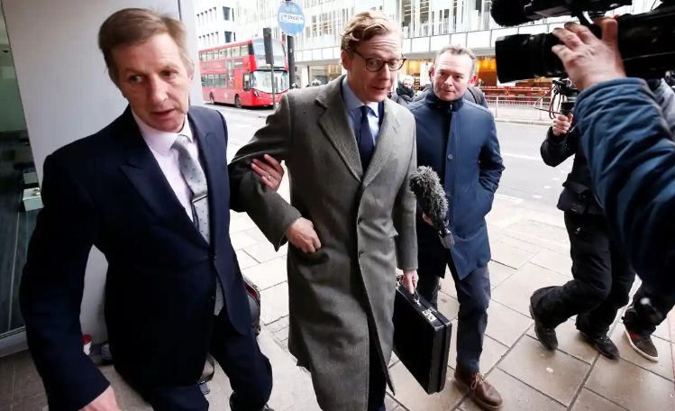
Cambridge analytica
Mairead O’Neill
Gained access to data from 87 million profiles [1]
  Larger than any psychological study
  No need to ask for permission
Took advantage of data correlations
  Likes
  Profile pictures [2]
[2]
[1] https://www.gsb.stanford.edu/insights/science-behind-cambridge-analytica-does-psychological-profiling-work
[2] https://www.theguardian.com/commentisfree/2018/mar/23/plenty-more-like-cambridge-analytica-data-facebook
Notes:
-A traditional study with 87 million participants would be a huge deal, yet data studies of this scale are common
-No need for consent to use data, users already agreed in Terms of Agreement
-People who “liked” Battlestar Galactica were likely to be introverts, for example, while people who “liked” Lady Gaga were likely to be extroverts. [1]
-Some correlations are less obvious, for example Cambridge Analytica researchers found that having alcohol in your profile picture correlates to being more hard-working. [2]

Slide 9
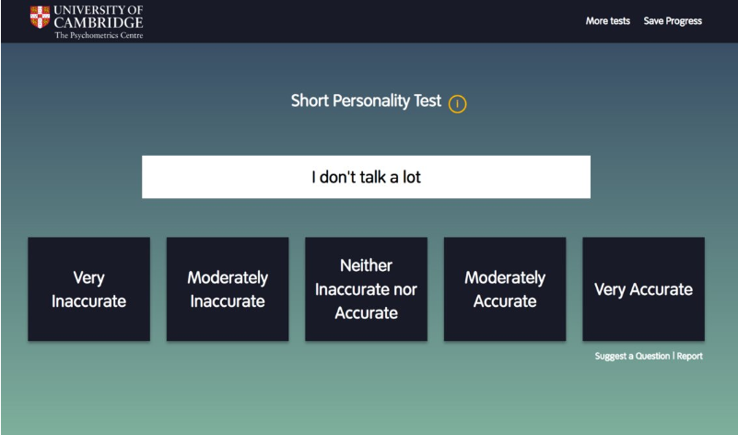
Cambridge analytics (continued)
Mairead O’Neill
Personality Test
  “Big 5 Personality Traits” [3]
  Data correlations
Used to generate Personality Profiles
  Test results used in combination with polls, voting records, and online activity [3]
[4]
[3] https://www.npr.org/2018/03/20/595338116/what-did-cambridge-analytica-do-during-the-2016-election
[4] https://www.businessinsider.com/facebook-personality-test-cambridge-analytica-data-trump-election-2018-3
Notes:
-120 question personality test, calculates score of “Big 5 Personality Traits”
-this image shows an example of one of the questions. While it doesn’t seem like any seriously personal or confidential data is being revealed, as we learned in previous slide, information like this can hint towards many other aspects of who you are, and with 120 questions, researchers were able to dig pretty deep
-also, these quiz results, along with polls, voting records, and online activity, were used to create personality profile to help Cambridge Analytics determine the most effective way to influence the target audience

Slide 10
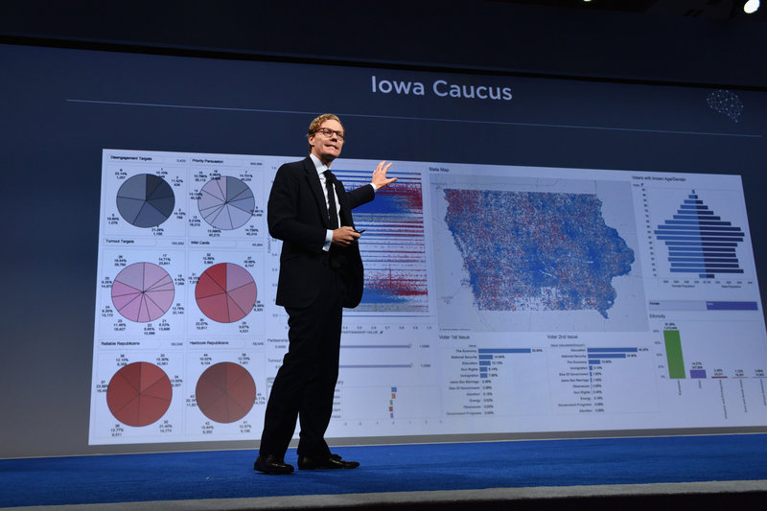
Can votes be bought?
Mairead O’Neill
Other Data Analytics Companies: [5]
  Democratic: BlueLabs, Clarity Campaigns, Civis Analytics
  Republican: Targeted Victory, Optimus, Deep Root Analytics
So why is Cambridge unique?
  Done illegally [3]
  Hired by Trump
[3]
[5] https://www.datasciencecentral.com/profiles/blogs/top-politics-focused-data-science-analytics-organizations
Notes:
-using data analytics companies for targeted ads is a common practice
-Clarity Campaigns worked for Obama, Targeted Victory worked for Mitt Romney
-Many companies do what they did, the only difference is that weren’t hired by Trump
-DONE ILLEGALLY: An outside researcher affiliated with Cambridge University, Aleksandr Kogan, developed an app in which users logged in with Facebook.
Kogan was allowed by Facebook to collect data about the user, AND their friends, for academic purposes. However, he was not allowed to share the data with a third party, which Kogan did with Cambridge Analytics
-Also took it f
-Goes to show that even when Terms and Conditions seem reasonable, you can never be sure that the data won’t end up in the wrong hands

Slide 11
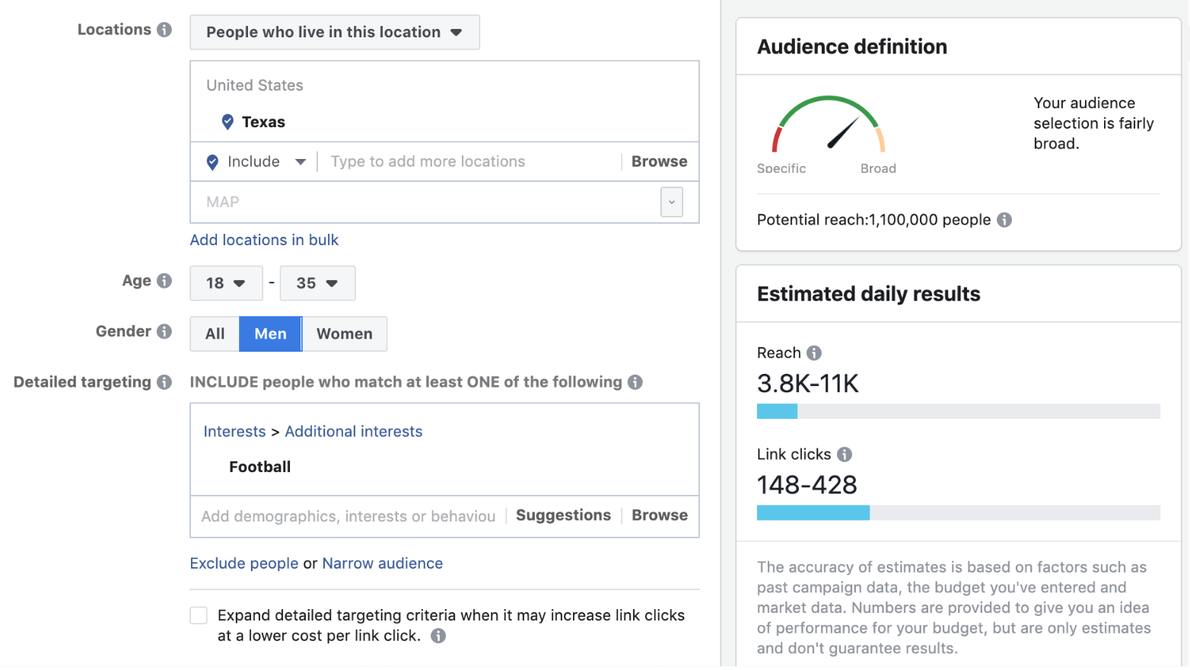
Mairead O’Neill
[6]
[6] https://medium.com/applied-data-science/56-070-165-facebook-ad-spend-of-us-presidential-candidates-broken-down-by-age-and-gender-2dcc32fe2c02
Notes:
-This is the page someone would see when buying a Facebook ad
-People would use companies like Cambridge Analytica so they could choose the right settings to maximize the influence of their ad

Slide 12
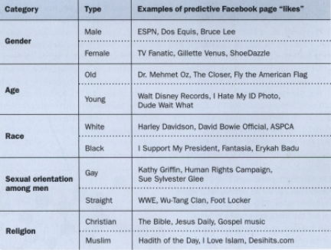
Kosinski’s study
Mairead O’Neill
  Mimicked Cambridge Analytica’s personality quiz
  People who saw tailored ads were 30% more likely to buy a product [1]
  Video game example [1]
    Changed ad from “Ready? Fire!...” to “Phew! Hard day? How about a puzzle to wind down with?”
    30% more clicks and 20% more downloads from introverts
[7]
[7]https://www.jstor.org/stable/23599035?Search=yes&resultItemClick=true&searchText=michal&searchText=kosinski&searchUri=%2Faction%2FdoBasicSearch%3FQuery%3Dmichal%2Bkosinski&ab_segments=0%2Fbasic_SYC-4341%2Ftest&refreqid=search%3Afd1c2a15e88212d5b596cae27ad79163&seq=1#metadata_info_tab_contents
Notes:
-Study lead by Michal Kosinski, a psychologist and assistant professor of organizational behavior at Stanford Graduate School of Business
-Changed text in a pre-existing ad for a video game that appeals to introverts

Slide 13
Kosinski’s study
Mairead O’Neill
“The big problem is that in the past, editorial policy was obvious. You could see if you were looking at a left-leaning or right-leaning paper… Now, a guy in the back-room, an engineer, can tweak a tiny thing that will affect the online environment for 1.6 billion people and no one would know. If Facebook decided to be liberal-leaning, nobody would even know because everyone sees a different thing. It’s creating different results for billions of people so it’s sort of difficult to measure, even for the owner of Facebook. No single person can claim to know how it works.” – Michal Kosinski [8]
[8] https://thepsychologist.bps.org.uk/volume-30/june-2017/fact-we-have-access-so-many-different-opinions-driving-us-believe-were
Notes:
Not only is big data a serious invasion of privacy for anyone who uses the internet, but it has enabled the psychological targeting of personalized ads, and normalized digital propaganda.

Slide 14
References
Mairead O’Neill
[1] Edmund L. Andrews, “The Science Behind Cambridge Analytica: Does Psychological Profiling Work?,” https://www.gsb.stanford.edu/insights/science-behind-cambridge-analytica-does-psychological-profiling-work (August 5th, 2019)
[2] Poppy Noor, “There are plenty more like Cambridge Analytica. I know – I've used the data,” https://www.theguardian.com/commentisfree/2018/mar/23/plenty-more-like-cambridge-analytica-data-facebook (August 5th, 2019)
[3] Scott Detrow, “What Did Cambridge Analytica Do During The 2016 Election?”, https://www.npr.org/2018/03/20/595338116/what-did-cambridge-analytica-do-during-the-2016-election (August 5th, 2019)
[4] Eric Brodwin, “Here’s the personality test Cambridge Analytica had Facebook users take,” https://www.businessinsider.com/facebook-personality-test-cambridge-analytica-data-trump-election-2018-3 (August 5th, 2019)
[5] Banjog, “Top Politics-Focused Data Science & Analytics Organizations,” https://www.datasciencecentral.com/profiles/blogs/top-politics-focused-data-science-analytics-organizations (August 6th, 2019)

Slide 15
References
Mairead O’Neill
[6] David Foster, “We Analysed the 527,350 Facebook Ads placed by the US Presidential Candidates. Here Are The Results,” https://medium.com/applied-data-science/56-070-165-facebook-ad-spend-of-us-presidential-candidates-broken-down-by-age-and-gender-2dcc32fe2c02 (August 5th, 2019)
[7]Rachel Ehrenberg, “What a Facebook ‘Like’ Reveals,” https://www.jstor.org/stable/23599035?Search=yes&resultItemClick=true&searchText=michal&searchText=kosinski&searchUri=%2Faction%2FdoBasicSearch%3FQuery%3Dmichal%2Bkosinski&ab_segments=0%2Fbasic_SYC-4341%2Ftest&refreqid=search%3Afd1c2a15e88212d5b596cae27ad79163&seq=1#metadata_info_tab_contents (August 5th, 2019)
[8] Poppy Noor, “’The fact that we have access to so many different opinions is driving us to believe that we’re in information bubbles,’” https://thepsychologist.bps.org.uk/volume-30/june-2017/fact-we-have-access-so-many-different-opinions-driving-us-believe-were (August 4th, 2019)

Slide 16
Targeted Ads
By Christopher Vieira
Notes:
Today I will be talking to you all about Targeted Ads.
I’ll be arguing that users of Google, Facebook, and countless other free online services have no right to complain about targeted ads or their information being collected

Slide 17
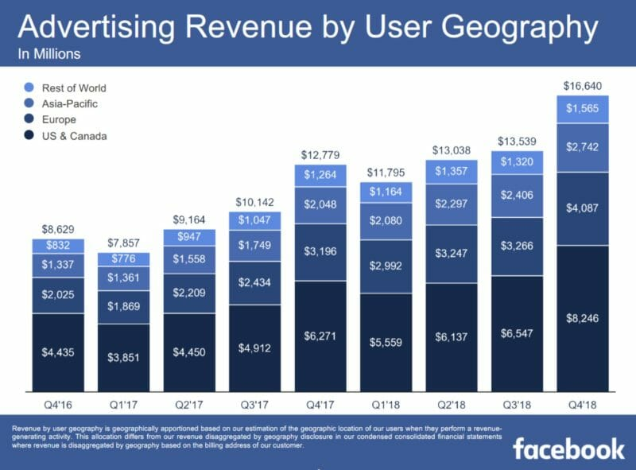
Practicality
Christopher Vieira
Service Costs
  Paying Employees
  Basic Maintenance Fees
  Bettering the Service
Facebook Example
  $41 Billion Yearly Operating Cost [1]
  2018 Ad Revenue is Roughly $42.3 Billion [2]
https://martechtoday.com/despite-ongoing-criticism-facebook-generates-16-6-billion-in-ad-revenue-during-q4-up-30-yoy-230261
Notes:
Start off questioning audience:
“Who here uses free internet services such as Facebook or Google? Who here feels all their information shouldn’t be gathered and used by the service?”
It is simply not practical for these services to not gather your information for profit.
These companies often have a slew of expenses, such as paying employees, basic maintenance fees or anything else that would result in the service being bettered.
Its not reasonable for the company to run off a model which doesn’t use its users’ data for profit or even self sufficiency to simply continue its existence.
To use Facebook as an example from June 30th of 2018 to June 30th of 2019, it had a total of 41 billion dollars as its operating cost.
Its total 2018 Ad Revenue, however, was 42.3 billion dollars, allowing it to continue to operate.
Facebook’s ad revenue has been rising every year in order to keep up with its operating costs, as seen in the table. From looking at the relationship between the operating cost and the ad revenue, the ad revenue has maintained a fairly linear relationship with yearly operating costs.
The idea of Targeting Ads is bettering the ability to show the right ads to users in order to generate more income, a process that these services should try to make more efficient and more profitable

Slide 18

Targeted ads are superior
Christopher Vieira
Beneficial to Consumer
  More relevant ads
  Discover new related products
Beneficial to Vendor
  Cheaper to advertise
  Advertising to correct audience
Change the Consumers’ Opinion of Themselves
  Especially if it is known that it is targeted [3][4]
Outside: August 2000, p. 39
Notes:
Going with a system that targets ads to consumers can end up being an efficient system that is superior to its alternatives, for both the consumers and vendors.
For the consumer there is the obvious increase in the relevance of the ads they are seeing, something we will talk about more in the next slide.
Additionally, consumers are given the opportunity to discover new products they may have not known of previously which they would be interested in.
For the vendor it is often cheaper to advertise or at least more profitable as your ad is being shown to individuals who are more likely to be interested in it.
It significantly reduces the amount of advertising wasted considering if a user’s profile indicates they would have no interest at all in a product, they wouldn’t be shown the ad ideally
Lastly, targeting ads have the very interesting and unique effect of changing the consumers’ opinion of themselves
Several studies have been conducted that show that consumers see themselves as being more of a certain trait if they think the ad was targeted to them in a certain manner based off of their interests
For example, one study conducted tested a hot chocolate ad that connected the product with the outdoors.
For the participants of the study that had interest in outdoors, they felt and more “outdoorsy” and were more likely to purchase the product.
The image on this slide can show such behavior in areas such as the person having a dog or enjoying the outdoors

Slide 19
Consumers prefer relevant ads
Christopher Vieira
71% prefer targeted ads [6]
32% want the ability to rate ads [6]
44% are willing to provide info [6]
  Name
  Email
  Product Preferences
  Address
Notes:
Along with the fact that targeted ads are more practical, efficient, and superior overall, they are preferred to the standard method of mostly random advertising on the consumer end.
A study was conducted in which 71% of those surveyed said they would prefer targeted ads over random ads.
They believed it would reduce irrelevant ads, would function as a way to discover new products, and would just making online shopping in general easier
Along with this, 32% would be willing to rate ads they received, furthering the process for targeting ads.
Of course this isn’t necessary but it would better the ability to target ads towards individuals
The most important to all of these statistics is that 44% of those surveyed would be willing to give personal info to a service for targeted ads
Granted, this information can be collected without the user directly inputting it for targeted ads but it would better the process more
It also reveals an interesting contradiction that 71% of individuals want targeted ads but only 44% would give personal information
Targeted ads can’t function without personal information and the user’s habits so its interesting that some would like to have ads relevant to them to magically appear without their information being collected

Slide 20
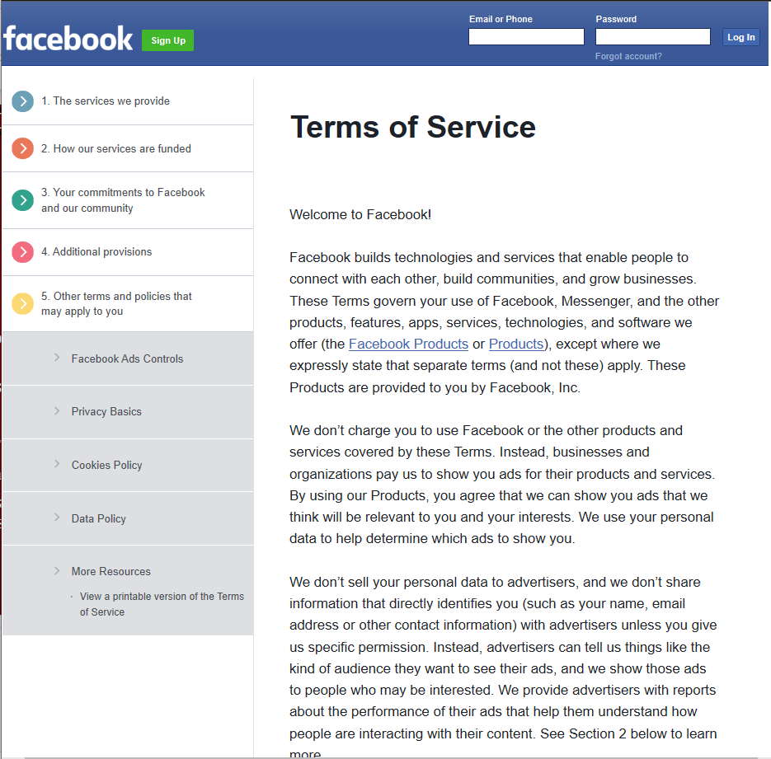
Terms of service
Christopher Vieira
Study found privacy is heavily valued [7]
  Privacy is a right – 73%
  An invasion of privacy to keep track of online activities – 68%
  Would stop using a website that had targeted ads – 34%
Facebook Terms of Service Ex
  The last line of the second paragraph:
  “We use your personal data to help determine which ads to show you” [8]
<Graphic as big as will fit>
https://www.facebook.com/terms.php
Notes:
A study was conducted by Ted Rogers School of Ryerson Management University which found privacy was heavily valued.
73% of the participants believed that it is a right for an individual to have when it comes to the internet
68% found that it was an invasion of privacy to keep track of a user’s online activities at any point
Then of course 34% of the participants of the study said they would stop using a website that had targeted ads or behavioral advertising
This study seems to show that privacy is heavily valued and the majority of people don’t want any of their online activities to be known
Some would go as far to stop using a website that tracks their activities
At the same time this argument seems to be made irrelevant through websites such as Facebook which blatantly say they collect your info.
In the second paragraph of the terms of service it states “We use your personal data to help determine which ads to show you”
The reason I wanted to show an image of the terms of service is how clear this line is displayed, not being hidden several pages down but blatantly being mentioned in the beginning of the text. There is no reason not to see it unless you completely neglected to read the terms of service.
This is a pretty standard statement for targeted ads, granted most people would not take the time to read it
It seems nearly impossible that if privacy is so heavily valued and people don’t want their online activities to be tracked that Facebook could be so popular
Either most individuals do not truly value their privacy or instead will not put in any effort to ensure their privacy is protected
Any of these websites can be avoided if someone is against their data being collected but most would not pay a monthly fee for such services
A widespread desire for privacy exists but most either never will act on it or would rather take the easier route

Slide 21
References
Christopher Vieira
[1] Macrotrends, Facebook Operating Expenses 2009-2019 | FB, https://www.macrotrends.net/stocks/charts/FB/facebook/operating-expenses (September 4th, 2019)
[2] Martech Today, Facebook ad revenue tops $16.6 billion, driven by Instagram, Stories, https://martechtoday.com/despite-ongoing-criticism-facebook-generates-16-6-billion-in-ad-revenue-during-q4-up-30-yoy-230261 (September 4th, 2019)
[3] Christopher A. Summers, Robert W. Smith, and Rebecca Walker Reczek, Targeted Ads Don’t Just Make You More Likely to Buy — They Can Change How You Think About Yourself https://hbr.org/2016/04/targeted-ads-dont-just-make-you-more-likely-to-buy-they-can-change-how-you-think-about-yourself (September 5th 2019)
[4] Christopher A. Summers, Robert W. Smith, and Rebecca Walker Reczek, An Audience of One: Behaviorally Targeted Ads as Implied Social Labels, https://academic.oup.com/jcr/article-abstract/43/1/156/2379732?redirectedFrom=PDF (September 4th 2019)
[5] Outside: August 2000, p. 39
[6] Holly Pauzer, 71% of Consumers Prefer Personalized Ads, https://www.adlucent.com/blog/2016/71-of-consumers-prefer-personalized-ads (September 6th 2019)
[7] Avner Levin, Privacy, Targeted Advertising & Social Media: How Big a Concern? Some Disconcerting Observations https://www.ourcommons.ca/Content/Committee/411/ETHI/WebDoc/WD5706433/411_ETHI_PSM_Briefs/LevinAvnerE.pdf (September 5th 2019)
[8] Facebook Terms of Service (September 7th 2019) https://www.facebook.com/terms.php
Notes:
Any Questions?

Slide 22
Class 6
The End
Keith A. Pray
Instructor
socialimps.keithpray.net
Notes:
This is the end. Any slides beyond this point are for answering questions that may arise but not needed in the main talk. Some slides may also be unfinished and are not needed but kept just in case.
If there’s time and we didn’t already look at:
Find out what your DNA says about you and your family.
https://www.23andme.com/
Jimmy Kimmel Live – What is your password? (2:49)
https://www.youtube.com/watch?v=opRMrEfAIiI

