Slide 1
Class 6
Information Privacy
Keith A. Pray
Instructor
socialimps.keithpray.net
Notes:
Here’s the title slide. Excited already, aren’t you?
How did the self search paper go?
Who: found a lot, very little, surprised, not surprised, creepy, share conclusions

Slide 2
Logistics
Address email to entire course staff for quickest response time
Presentations are due 24 hours before class
Any course logistic questions?
Notes:
Not needed this time:
Address email to entire course staff for quickest response time
Send presentations via email as attachment.
Do not change the format, footers, etc. in the template slides.
Paper writing process: Sources → Notes → Conclusion → Argument → Counter Point → Response
Turn extra credit paper in on myWPI/Canvas and hard copy in class like regular papers
Presentations are due 24 hours before class
Use Presentation Guidelines on course web site

Slide 3
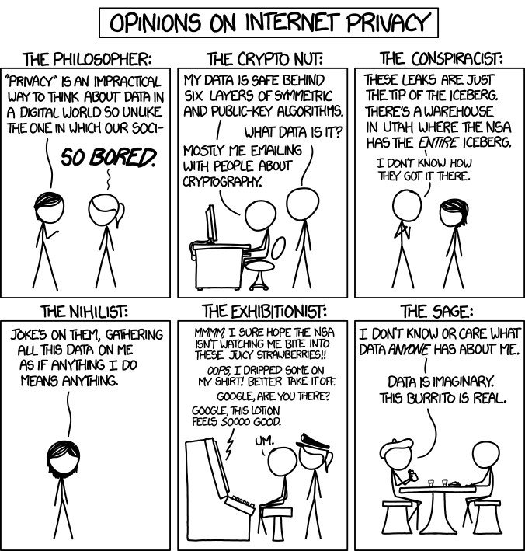
Overview
Review
Assignment
Students Present
http://xkcd.com/1269/
Notes:
1 – Accessed 2014-04-14

Slide 4
My Reading Notes
pp. 229 means to end?
pp. 230 who videotapes anymore?
pp. 231 “businesswoman” nice change. Moral capitol – source published in 1984, “taking away” “1984”
pp. 234 Hilton consent to pic being in book?
pp. 237 Many daycares monitor, any studies yet?
pp. 238 “…privacy…in their own homes…” != nanny to expect privacy “…when… insides Sullivans’ home.
pp. 244 Human chip implant sources getting old, 2002, 2004, 2007, 2010
pp. 250 2012 source same year Target outed pregnant teen to parents
pp. 255 Why did Apple not enforce policy of asking permission in the API?
pp. 245 “…by 2015” did it happen?
pp. 246 Web Browsers put cookies on on your hard drive, not Web Servers.
pp. 250 why is bills – responsibility assumption flawed?
pp. 268 Why WPI not in list?
Notes:
Find out what your DNA says about you and your family.
https://www.23andme.com/
https://motherboard.vice.com/en_us/article/xwkaz3/23andme-sold-access-to-your-dna-library-to-big-pharma-but-you-can-opt-out?utm_source=vicefbus
Jimmy Kimmel Live – What is your password? (2:49)
https://www.youtube.com/watch?v=opRMrEfAIiI
Notes updated: 2018-04-03

Slide 5
Assignment
Prepare for class debate: Is a National ID System a good thing?
  Come prepared with notes, facts, dates, high quality sources
  You can build upon your self search work
  Optional One Page Paper on the topic, lowest paper grade will be dropped

Slide 6
Overview
Review
Assignment
Students Present

Slide 7
Selecting your feed
Brian Fay

Slide 8
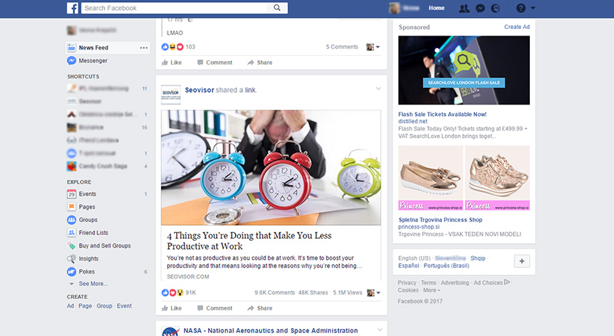
How websites sort your feed
Brian Fay
Lots of potential posts
  Can’t show everything
What gets selected?
  Who selects it?
  Selection criteria?
<Graphic as big as will fit>
Notes:
Websites need to decide what your feed will be out of thousands of potential posts. Its impossible to show everything. User might miss something important, or become uninterested.
How are these feeds selected? Who selects it, and what is it selected for.

Slide 9
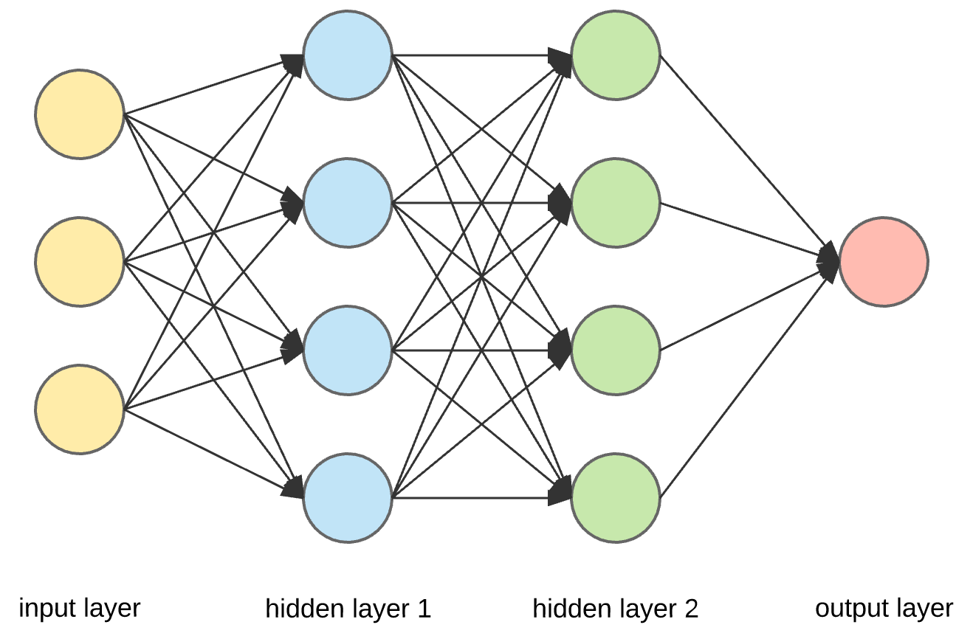
Algorithms
Brian Fay
Neural networks
  Valuable trade secrets
  Tested
  “Killed”
  Random mutations
Need lots of data
[1][8]
Notes:
Neural networks are a good model to understand how these algorithms are built.
The exact model used by major web sites is unknown, as these search engines are very valuable trade secrets.
They evolve.
A network will be tested to create a feed for a user.
Graded on how well the feed preformed.
Best graded ones survive. Others die.
Then they get random “mutations”.
Cycle repeats.
Most successful mutations are kept over iterations, making very successful programs without humans deliberately designing them.
Data is needed to create tests.
Lots of data.

Slide 10
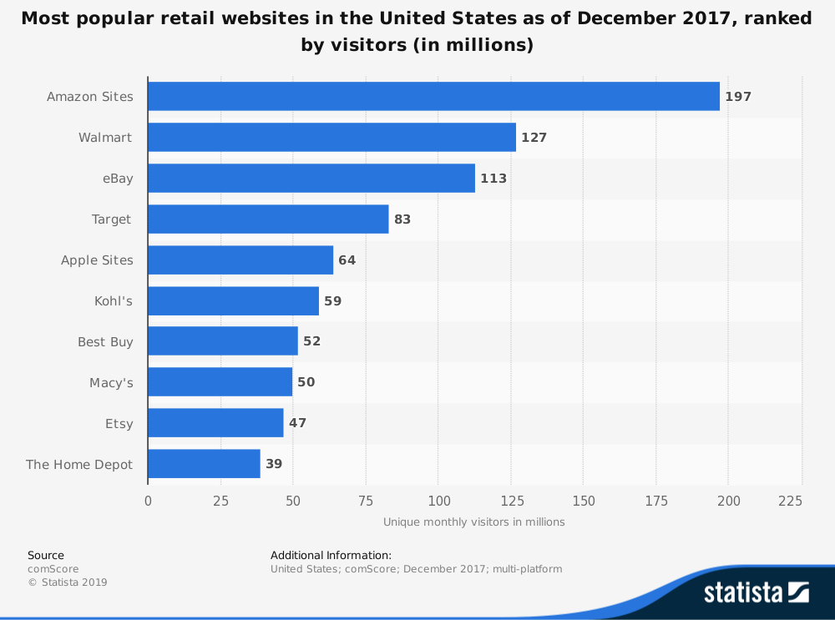
You provide the data
Brian Fay
Past interactions
  Liked posts
  Purchased items
  Watched videos
Data makes tests
How are they graded?
[2][7]
Notes:
For retail sites like amazon, there is lots of data for them to tap into from their users.
They get data from your liked posts, purchased items, watched videos, how long you watched for.
This data is then used to make the tests for the algorithms
What is the grading criteria?

Slide 11
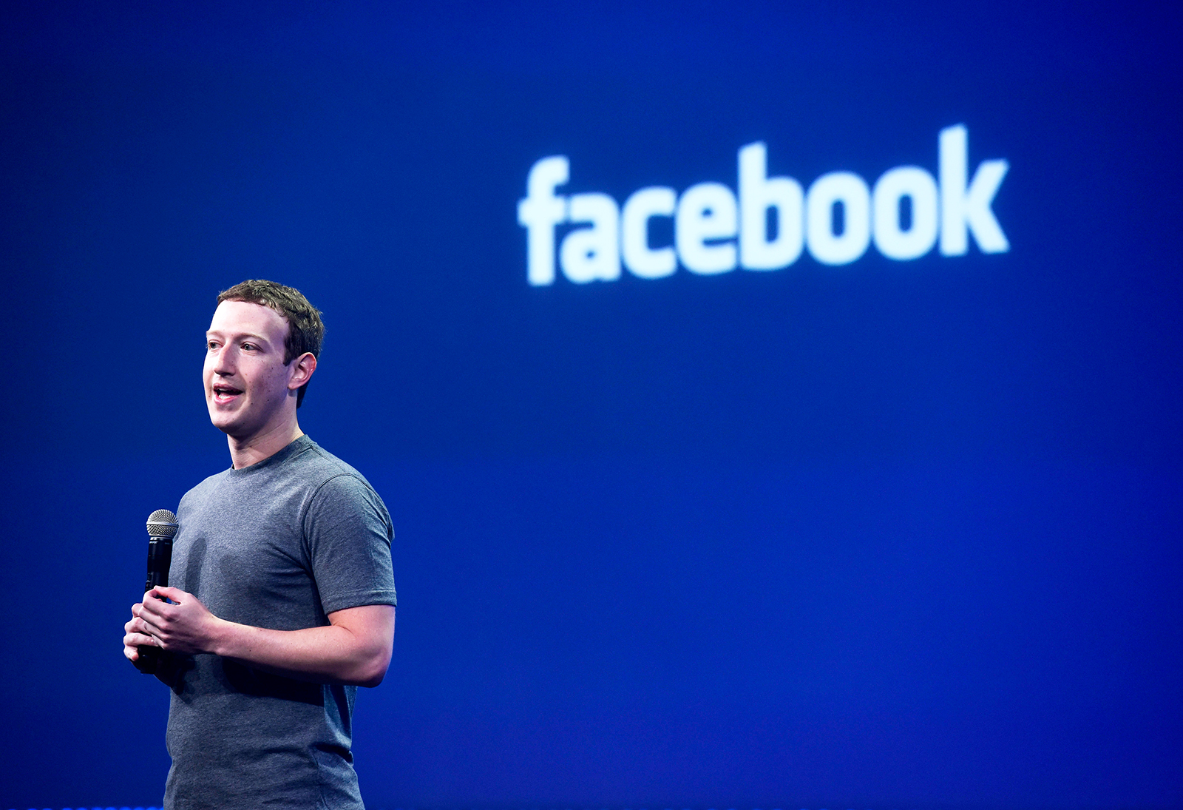
Selection criteria
Brian Fay
Big impact on content
Facebook
  2018 algorithm change
  Close interactions
  Pages lost 50% of viewers
<Graphic as big as will fit>
[3][4]
Notes:
Big impact on content. 10:04 minute videos on YouTube caused by preference for 10 minute videos.
Facebook made an algorithm change in 2018 to prioritize posts that sparked conversations between close friends and family.
Pages saw a 50% decline in views.
KAP addition:
CPG Grey - This Video Will Make You Angry [Thought Germs] (7:25)
https://www.youtube.com/watch?v=rE3j_RHkqJc

Slide 12
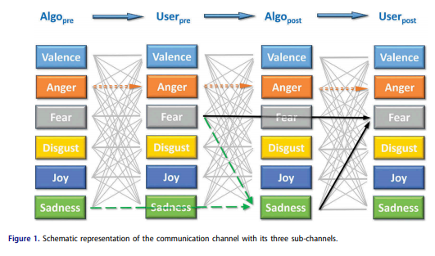
Societal impacts
Brian Fay
Magnifies transferable emotions
  Popular videos affect emotion
  Emotion dictates videos watched
  Videos watched impact algorithm
This magnifies emotions
[6]
Notes:
A feedback loop of emotions is also created by these algorithms.
Most potent videos are selected by algorithms as well as people, helping the process shown in the video
Graphic is from a 2018 study done using Youtube recommendation feeds.
Found that emotions found in popular videos influence users, who then elect videos based on these emotions.
These video selections then change the algorithm.

Slide 13
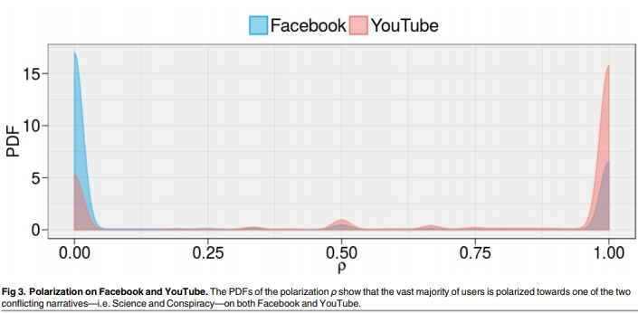
Polarization
Brian Fay
Positive experiences or engagement
Users prefer confirming content
  Algorithm provides
Polarizes society
  People pulled to either side
[5]
Notes:
Many websites use engagement or positive experiences to score how well their algorithms are doing.
Facebook did before the 2018 update.
Users prefer content that confirms their previously held notions, while the algorithm serves it to them.
This creates echo chambers, people within group discussing amongst themselves, helping the totem creation shown in video.
This causes polarization in society. People who deviate one way will be pulled to the extreme.
The x axis represents how much a user prefers videos sorted into either science or conspiracy.
Note the small bump in the middle that was not far enough in either direction to start this polarizing effect.

Slide 14
Users should be informed
Brian Fay
Data collection
  Users constantly monitored
Data usage in algorithm
  Extremely valuable
  Far reaching effects
Privacy violations
Notes:
Privacy concerns.
Is the collection of your data a privacy violation?
Users should be made more aware of this process.
User data is constantly being collected for usage in creating algorithms.
People usually aren’t aware of how much data is being mitered, collected, and monetized.
This data is then used to refine valuable algorithms that have far reaching impact, influencing the users opinion, state of mind, or purchasing habits.
Users should be made more aware of the usage and collection of their data, and be more aware of how the biases of the algorithms will influence them, just as they need to be aware of how their own cognitive biases affect them.

Slide 15
References
Brian Fay
[1] Hardesty, Larry, and MIT News Office. “Explained: Neural Networks.” MIT News, MIT News Office, 14 Apr. 2017, news.mit.edu/2017/explained-neural-networks-deep-learning-0414.
[2] (Y. Dai, H. Ye, and S. Gong 100-103) https://ieeexplore.ieee.org/abstract/document/4771888
[3] Mosseri, Adam. “Bringing People Closer Together.” Facebook Newsroom, Facebook, newsroom.fb.com/news/2018/01/news-feed-fyi-bringing-people-closer-together/.
[4] Erskine, Ryan. “Facebook Engagement Sharply Drops 50% Over Last 18 Months.” Forbes, Forbes Magazine, 13 Aug. 2018, www.forbes.com/sites/ryanerskine/2018/08/13/study-facebook-engagement-sharply-drops-50-over-last-18-months/#713d962694e8.
[5] : Bessi A, Zollo F, Del Vicario M, Puliga M, Scala A, Caldarelli G, et al. (2016) Users Polarization on Facebook and Youtube. PLoS ONE 11(8): e0159641. doi:10.1371/journal.pone.0159641
[6]:(Hilbert et al. 260-275) https://www.tandfonline.com/doi/citedby/10.1080/19312458.2018.1479843?scroll=top&needAccess=true
[7]comScore. "Most Popular Retail Websites in The United States as of December 2017, Ranked by Visitors (in Millions)." Statista - The Statistics Portal, Statista, www.statista.com/statistics/271450/monthly-unique-visitors-to-us-retail-websites/, Accessed 29 Mar 2019
[8] Sullivan, Danny. "How search engines work." SEARCH ENGINE WATCH, at http://www. searchenginewatch. com/webmasters/work. html (last updated June 26, 2001)(on file with the New York University Journal of Legislation and Public Policy) (2002).

Slide 16
ANDROID APP PERMISSIONS
Too Many?
Vinit Kothari

Slide 17
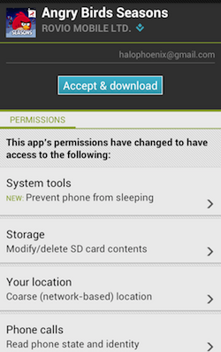
APP PERMISSIONS EARLIER
Vinit Kothari
Shown when downloading the App
Must accept
<Graphic as big as will fit>
[2]
Notes:
A key detail about Android apps has been that they ask more permissions than what they need. Before the creation of Android 6.0 app permissions were shown to the users when downloading the app and users had to accept these permissions. Users were always worried about this as they had no clue why a certain app would ask for certain privileges or permissions. As shown in the picture you can see that a simple game of Angry Bird was requesting access to phone calls and wanted to read phone state and identity, which meant giving the game more than it needed.

Slide 18
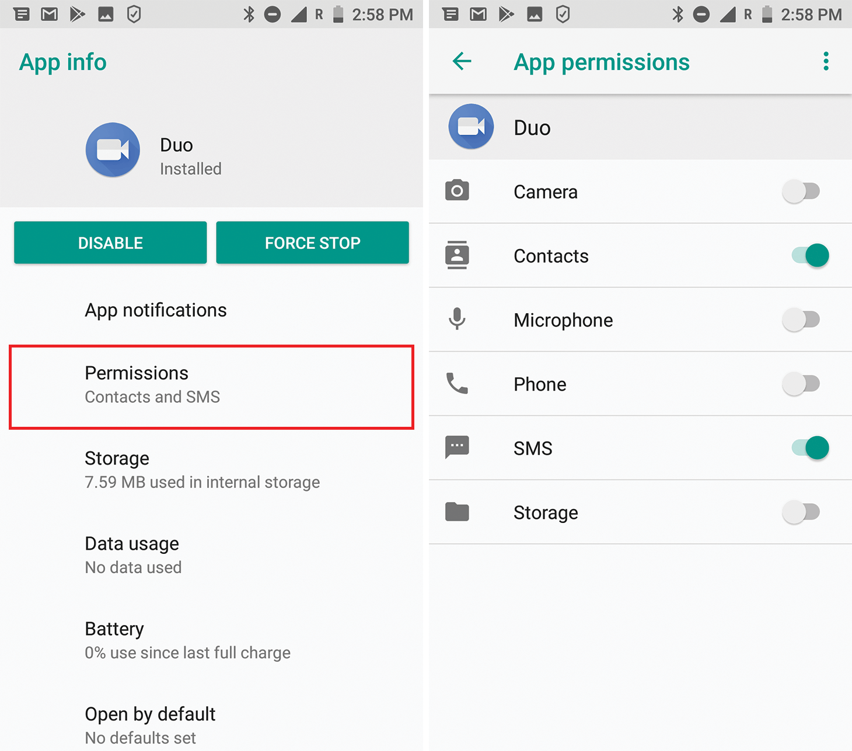
Permissions NOw
Vinit Kothari
Android asks users for permissions
Option to allow or deny
Changed with Android 6.0
<Graphic as big as will fit>
[3]
Notes:
Android apps now ask users for permissions, and users can go into settings and change what they previously chose for permissions. This allows users more control over the device as the users can decline whatever permission they feel is a threat to them. This change was introduced in Android 6.0 (Marshmallow) and has continued all the way up to Android 8.0( Oreo).

Slide 19
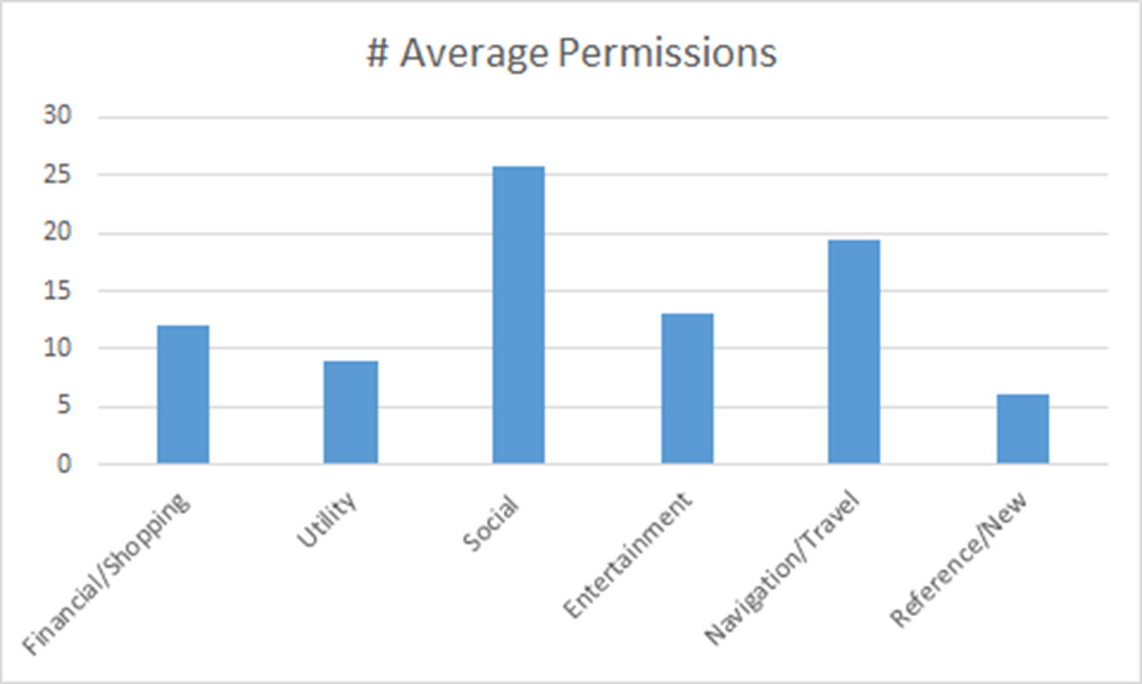
Amount and TYPES of Permissions
Vinit Kothari
USER: Any permission that serves the main functionality of the application (ex: Google Maps and using the GPS)
VENDOR: Any permission that does not serve the main functionality of the application. (ex Facebook keeping track of App History)
AMBIGUOUS: Any permission that is either optional or has the potential to be used maliciously. (ex: any access to SD cards or In app purchases)
<Graphic as big as will fit>
[4]
Notes:
Permissions can be divided into 3 groups USER, VENDOR and Ambiguous. User is anything that is essential to app functionality, vendor is anything that does not server main functionality. Ambiguous is a permission that has the potential to be used maliciously and is often optional. From a study conducted, the chart shows that out of Social apps ask for the most information, on an average they ask for about 25 permissions, which is the highest among all the categories. This could mean that social apps ask for the most permissions which is about 5 times as Reference Apps. This table shows that in total on average an android app asks for about 14 permissions, which again means that most of the android apps ask for more permissions than they need.

Slide 20
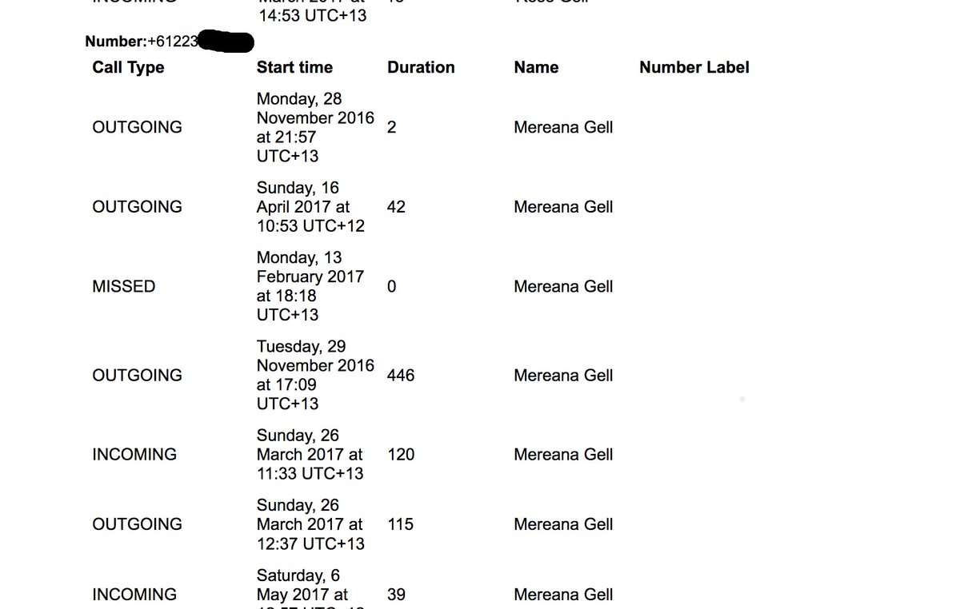
Do USERS have privacy?
Vinit Kothari
Pre-installed apps/ Privileged Apps
Already have permissions
Facebook
Information Disclosure
<Graphic as big as will fit>
[2]
Notes:
Pre-Installed apps already have permissions to get access to user data
Facebook had logs of all users. A user posted this image of his call logs between him and his girlfriend that Facebook collected. The person who posted this on twitter was not sure of how Facebook managed to get the entire call log between him and his girlfriend. Although what was the case Is when the app is started Facebook it has an Opt-In feature which is by default on for users without even their consent. This feature allows Facebook to sync call and text history saying that it makes it easier for them to connect people to their friends . This is only a feature on Android.

Slide 21
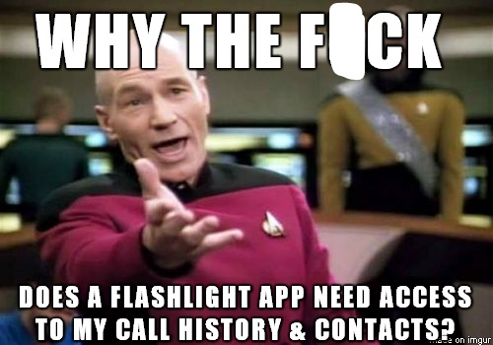
Data Mining
Vinit Kothari
7 in 10 apps share data
Uber prevents cops from riding
Facebook gave Cambridge Analytica data for 87 million users
Vendor and ambiguous
<Graphic as big as will fit>
[1]
Notes:
Apps ask for information, however once agreed to give, they have access to that information and to do whatever with it until the user turns it off. Facebook shared data of 87 million users with Cambridge Analytica . Most of this happens due to vendor and ambiguous permissions. Users accept such permissions because there is not much information given to the user about it. Uber however used the feature of data mining in its car ride app to prevent cops from using the service. If that wasn’t enough they even tracked a user’s location even when they were not using the app

Slide 22

POKemon GO Misuses Permissions
Vinit Kothari
In 2018 Pokemon go misused the access to internal storage
Used to check if device was rooted
Storage accessed even when not allowed
Blocked players who were rooted even if they did not get cheats
<Graphic as big as will fit>
[6]
Notes:
In 2018 when Pokémon go abused it’s internal storage permission . Users normally gave this permission to the game to create game save files and other game related data in the internal storage, hence all users would give the app this permission. However Niantic misused this permission and checked the storage to figure out if the device was rooted. This is because some cheats can be installed after a device is rooted. Although this does not necessarily mean that rooting is the same as cheating as there were many users who rooted their phone just to get better functionality and performance from the device. What was more worrying was when users turned declined the permission to allow Pokemon go to access storage it still was able to check the storage and prevent rooted users from playing the game.

Slide 23
Conclusion
Vinit Kothari
Apps ask for more permissions than necessary
Most applications have a majority of user locations that helps users use the app better
However a decent amount of them are vendor and ambiguous
Laws should be passed to prevent apps for asking information about anything that’s not required for an app to run
[1,2,3,4,5]
Notes:
To conclude android apps ask for permissions more than they need. Most of these permissions are user permissions that are used in the main functionality of the app however there are some permissions that are not at all useful in the app and can give apps the data and crucial information about the user. Such as a game for example wanting access to contacts or phone settings. Hence users should be careful about what they agree to as a lot of the apps can misuse this information as it is found that an average of 7 in 10 apps share data. Some permissions can also be exploited by an app as was the case for Pokémon Go where it exploited it’s permission to access the storage and was even able to do so when not given the permission to access storage. Hence Laws should be passed that ensure that an application does not ask for information aside from what it already needs for the app to run.

Slide 24
References
Vinit Kothari
[1] http://theconversation.com/7-in-10-smartphone-apps-share-your-data-with-third-party-services-72404 25/03/2019
[2] https://lifehacker.com/why-does-this-android-app-need-so-many-permissions-5991099 25/03/2019
[3] https://www.kaspersky.com/blog/android-8-permissions-guide/23981/ 25/03/2019
[4] https://www.pewinternet.org/2015/11/10/an-analysis-of-android-app-permissions/ 26/03/2019
[5] https://arstechnica.com/information-technology/2018/03/facebook-scraped-call-text-message-data-for-years-from-android-phones/ 27/03/2019
[6] https://www.androidcentral.com/pokemon-go-app-reading-files-your-phone-theres-reason 28/03/2019
[7] https://techcrunch.com/2019/03/25/android-users-security-and-privacy-at-risk-from-shadowy-ecosystem-of-pre-installed-software-study-warns/ 28/03/2019

Slide 25
They’re Watching You:
The Effectiveness of Computer Monitoring
By: Xavier McLean
Notes:
First I need to explain the background information
Some of this touches on stuff covered in the textbook, but it is nonetheless relevant to develop my case
Workplace Delinquency
Delinquencies can be considered anything that goes against the sanctions of a company or employer
There are many types of this but to give you an idea: Sabotage, Harassment, Vandalism, Misuse of Assets
Time Theft
One specific occurrence of Delinquency is Time Theft
This is what we would refer to as slacking off, not doing work during company hours
This may seem trivial at first, but to companies this is no joke
Employer Prevention
While these are clearly undesirable in their own right, all these issues boil down to one bigger issues for employers: they cost money
Companies want to prevent money loss
By “right”, I refer to methods of employee selection oriented towards certain characteristics and personality traits that weed out potential delinquents in the first phases
Types of Computer Monitoring
Computer Monitoring has two predominant components
There are clearly benefits and substantial reasons for many iterations of surveillance
The question I pose is… Is Computer Monitoring Effective in Preventing Time Theft
My argument is NO
By this, I do not mean that it is without use
Monitoring has it’s place in the workplace
I feel that the approach is not reducing time
Arguments for Employers
The fact that the Employees are Being Paid to Work affords the Employers is irrefutable
The second point is valid as well, what people do on your networks/assets is to some degree your business
The Company is able to take very accurate metrics including “counting and timing keystrokes.” This allows the employer to know how effective an employee is
A logical conclusion based off this info is that measures could easily be taken to increase worker productivity
Employees
Although the company can claim access to this invasive information on their network, it does not make it necessarily ethical
Many employees are uncomfortable by the idea of an employer going through their personal electronic messages and every key they type
It creates an environment of fear and distrust
Although this monitoring would force employees to always be working, it doesn’t mean their work quality will increase. In fact, this promotes hasty work and less investment of effort
It’s shady to not tell employees you monitor, besides half of the effect is not present (the fear)
When the monitored content is not communicated, it lends to more distrust because it seems like random, untargeted search and seizure
Employees are more open to monitoring when it’s told what is being surveilled. The less that is known, the more likely employees might attempt legal action which uses time and money
There is also reason to suggest that the time “wasted” during the day is needed for better productivity
At the end of the day, there isn’t much use in monitoring keylogging nor email communications because all intended benefits would be counteracted and potentially backfire
Support (Slide 9)
“In a study of 461 electronically monitored workers and 283 non-monitored workers…monitored workers reported higher levels of workload and work pressure. Found that monitored employees felt quality was foregone for quantity. More than 75% of the monitored workers said production quantity was the most important factor in their performance ratings, while more than 75% of the non-monitored workers” [5]
“700 electronically monitored office workers were questioned…Employees who were being monitored and who participated in the survey complained that the implementation of electronic monitoring in their workplace caused paced work, lack of involvement, reduced task variety and clarity, reduced peer social support, reduced supervisory support, fear of job loss, routinized work activity, and lack of control over tasks.” [5]

Slide 26
Computer Monitoring IS Not Effective in Preventing Time Theft
Xavier Mclean
Workplace Delinquency
Time Theft
How Employers Prevent It
Types of Computer Monitoring
The Argument for Employers
The Employee Side
Conclusion
Notes:
<speaker notes>

Slide 27
Workplace Delinquency
Xavier Mclean
Comes in many forms:
Sabotage
Harassment
Vandalism
Misuse of Assets
Notes:
<speaker notes>

Slide 28

Time THEFT
Xavier Mclean
Definition: Time not spent work during sanctioned work time
The most prevalent form of Workplace Delinquency
Average Employee wastes 2.09 hours per 8 hour workday, which equates to roughly $759 Billion in loses in the U.S. [1]
Notes:
<speaker notes>

Slide 29
Employer Prevention
Xavier Mclean
Two main methods:
Hiring the “right” employees
Correcting employee behaviors through organization control systems (Electronic Surveillance) [2]
80% of US corporations keep their employees under regular surveillance [3]
Notes:
<speaker notes>

Slide 30
Types of Computer Monitoring
Xavier Mclean
Keylogging – “the recording of keystrokes on an employee’s computer to provide a map of what Web sites the employee is visiting” [6]
E-mail Interception – the review of all electronic communications made on company assets
Notes:
<speaker notes>

Slide 31
The Argument for Employers
Xavier Mclean
Employees are being paid to work
This information is collected on company assets
Provides very accurate information about efficiency of workers (helpful for feedback)
Increases productivity of workers
Notes:
<speaker notes>

Slide 32
Employees
Xavier Mclean
Breach of Privacy
Shows lack of trust
Quantity of Quality
Employees are less aware of monitoring
What is being monitored is rarely communicated
Creates less dialogue with Management
Notes:
<speaker notes>

Slide 33
Support
Xavier Mclean
“More than 75% of the monitored workers said production quantity was the most important factor in their performance ratings, while more than 75% of the non-monitored workers” [5]
“Employees…complained the implementation of electronic monitoring in their workplace caused paced work, lack of involvement, reduced task variety and clarity, reduced peer social support, reduced supervisory support, fear of job loss, routinized work activity, and lack of control over tasks.” [5]
Notes:
<speaker notes>

Slide 34
Support
Xavier Mclean
“Apart from the issue of decreased productivity, when employees may simply leave work early or take time off to devote to personal or family matters. Moreover, supervisors and managers will inevitably spend more of their time reviewing employee communication. There could also be legal costs if a suit is brought, even if it appears likely that no specific law has been violated ” [7]
Notes:
<speaker notes>

Slide 35
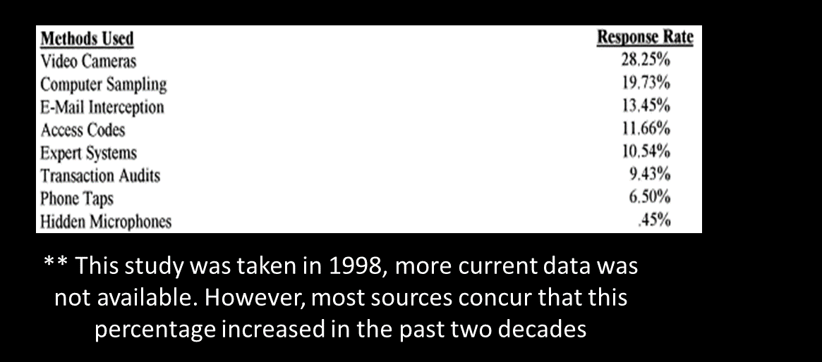

Support
Xavier Mclean
Notes:
<speaker notes>

Slide 36
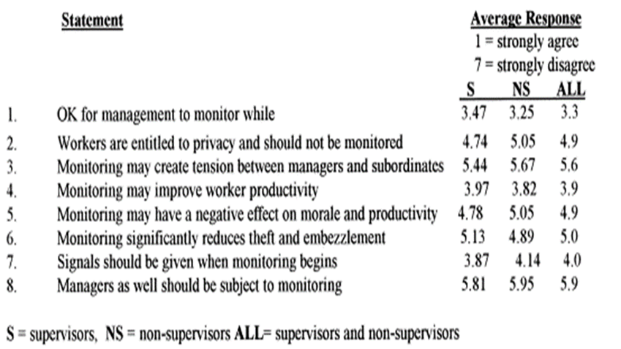

SupPort
Xavier Mclean
<Supporting phrases>
<Remove “<“ “>” from template
<Graphic as big as will fit>
Notes:
<speaker notes>

Slide 37
Conclusion
Xavier Mclean
Monitoring is needed
Computer Monitoring is NOT effective in preventing Time Theft
Awareness of monitoring is important
Notes:
<speaker notes>

Slide 38
References
Xavier Mclean
[1] Malachowski D., Wasted time at work costing companies billions(2005) http://sfgate.com/cgibin/article.cgi?f=/g/a/2005/07/11/wastingtime.TMP Accessed March 28th, 2019
[2] Anglim J., Lievens F., Everton L., Grant S.L., Marty A., HEXACO personality predicts counterproductive work behavior and organizational citizenship behavior in low-stakes and job applicant contexts, Journal of Research in Personality, Volume 77, 2018, Accessed March 28th, 2019
[3] Schmitz, Patrick W. , Workplace surveillance, privacy protection, and efficiency wages, University of Bonn and CEPR, Wirtschaftspolitische Abteilung, Adenauerallee 24-42, Bonn D-53113, Germany, 2004.
[4] R.H Irving, C.A Higgins, F.R Safayeni, Computerized performance monitoring systems: Use and abuse, Communications of the ACM, 29 (1986), pp. 794-801
[5] EffyOz a, RichardGlass b, RobertBehlingb, Electronic Workplace Monitoring: What Employees Think, a- Department of Management Science and Information Systems, Penn State University, Malvern, PA 19355, USA, b- Department of Computer Information Systems, Bryant College, Smithfield, RI 02917, USA, 1998
[6] Giuliano, Jim, “'Keylogging' to Check Internet Usage: Is It Legal?”, HR News & Insights, 12 June 2009, www.hrmorning.com/internet-usage-the-legality-of-keylogging/, Accessed March 28th, 2019
[7] Sonny S.Ariss, “Computer monitoring: benefits and pitfalls facing management”, College of Business Administration, The University of Toledo, 2801 West Bancroft Street, Toledo, OH 43606, USA, 2001

Slide 39
Class 6
The End
Keith A. Pray
Instructor
socialimps.keithpray.net
Notes:
This is the end. Any slides beyond this point are for answering questions that may arise but not needed in the main talk. Some slides may also be unfinished and are not needed but kept just in case.
If there’s time and we didn’t already look at:
Find out what your DNA says about you and your family.
https://www.23andme.com/
Jimmy Kimmel Live – What is your password? (2:49)
https://www.youtube.com/watch?v=opRMrEfAIiI

